Slide 1
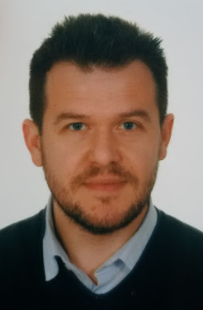

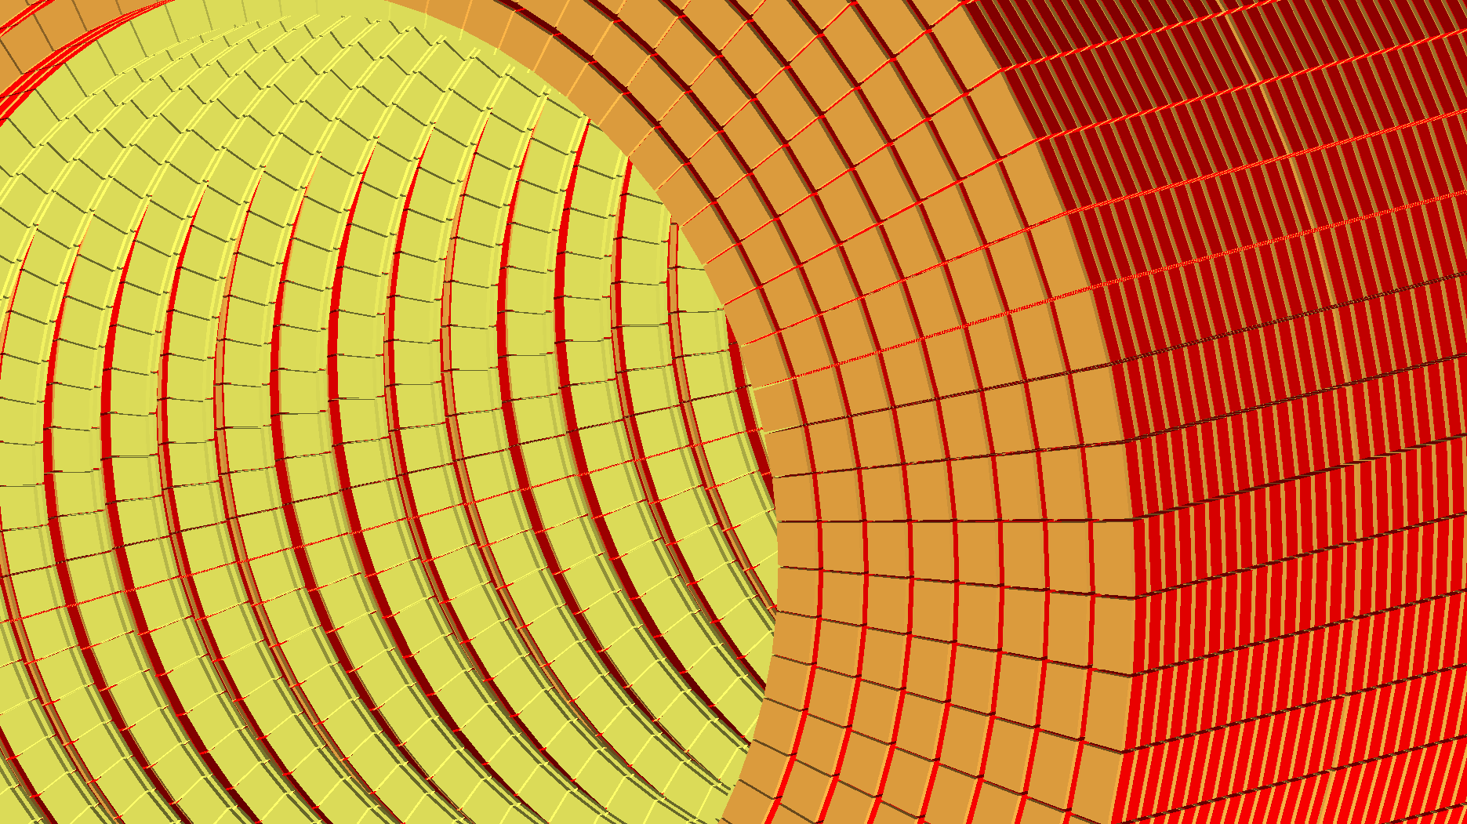

ENUBET
Enhanced NeUtrino BEams from kaon Tagging
A. Longhin (PI, INFN-PD)
Hyper-K open meeting
London, 10/07/2016
e⁺
n_{e}
K⁺
Host Institution
ERC-Consolidator Grant-2015, nº 681647 (PE2)
Notes:
Good morning, and thank you for your invitation. My name is Andrea Longhin. I will present ENUBET which stands for “Enhanced neutrino beams from Kaon tagging”. With this proposal I intend to demonstrate the feasibility of a device which can give a huge boost to the field of neutrino physics.

Slide 2
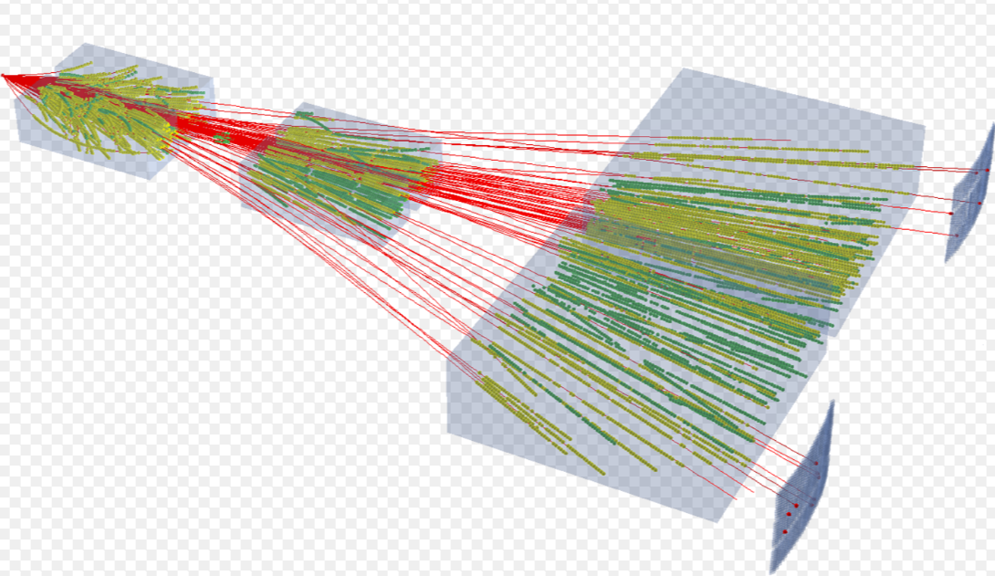
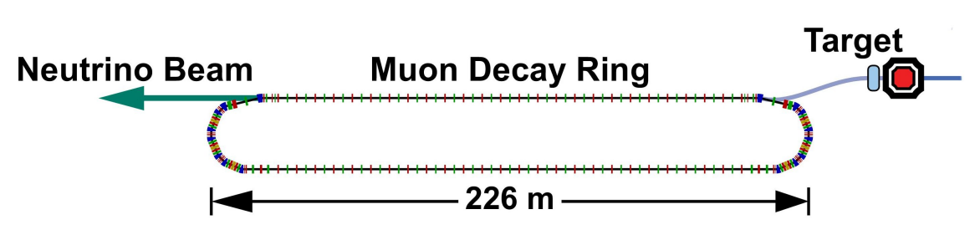
The ENUBET approach
In the last ten years, our knowledge of n cross sections has improved enormously. Vigorous experimental programme (T2K, MINERvA, SCIBooNE, MiniBooNE etc.) motivated by the needs of the precision oscillation physics. Still:
no absolute s with precision < 10% (mainly flux systematics)
  Mitigation: hadro-production exp.s. SPY, HARP, NA61
  Mitigation: constrain flux using interactions with e ? small cross section
n_{e} cross sections are sparse (Gargamelle, T2K, NovA). Beam contamination.
  we do not have intense sources of n_{e} in the GeV energy range
  (ideal) solution: i.e. decay in flight of stored muons (nuSTORM)
ENUBET: build a pure source of n_{e} employing conventional technologies reaching a precision on the initial flux < 1%

Slide 3
Tagged electron neutrino beams
n_{e}
neutrino
detector
protons
Hadrons (K, π)
K decays
e⁺
  The problem of predicting the ν_{e} flux at the neutrino detector
A traditional beam
The tagged beam
Passive decay region
ν_{e} flux relies on ab-initio simulations of the full chain
large uncertainties from hadro-production
Fully instrumented decay region
K⁺ → e⁺ ν_{e} π⁰ → large angle e⁺
n_{e} flux prediction = e⁺ counting
↔
Notes:
From the conceptual point of view, ENUBET is very simple. Conventional neutrino beams produce neutrinos hitting protons on graphite targets. The particles that are produced by the protons, mostly pions and kaons, are collected and sent into a decay tunnel. In this tunnel, the particles decay and produce neutrinos. The main source of systematic errors in conventional neutrino beams come from the fact that we cannot measure directly the flux of neutrinos produced in the decay tunnel and we have to rely on simulations and indirect measurements. ENUBET will build a detector that, for the first time is able to measure the positrons that are produced in the decay tunnel in association with the electron neutrinos. Since there is a one-to-one correspondence between positron and electron neutrinos, this is a direct measurement of the neutrino flux at source: exactly what we need to reach a 1% precision on the cross sections.

Slide 4
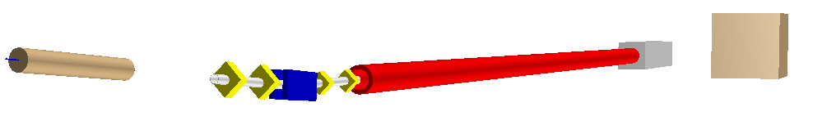
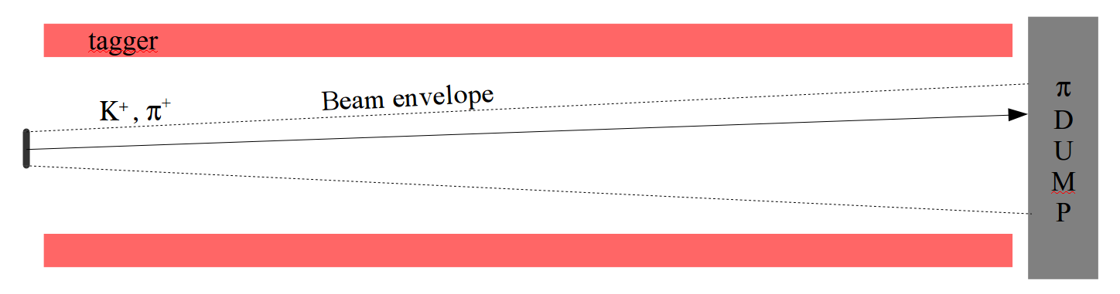
Towards the first tagged n_{e} beam
A baseline setup to implement this idea proposed in:
A. Longhin, F. Terranova, L. Ludovici Eur. Phys. J. C (2015) 75:155
Hadron beam-line
e⁺ tagger
Neutrino detector
K⁺ decay
protons
e⁺
n_{e}
K/p
Residual
proton dump
Hadron beam-line: collects, focuses, transports K⁺ to the e⁺ tagger
e⁺ tagger: real-time, ''inclusive'' monitoring of produced e⁺
Positron tagging: uncertainties from K hadro-production, PoT, hadron beam-line efficiency become irrelevant for the n_{e} flux prediction
Hadron collimation: allows having only decay products in the tagger.
→ tolerable rates
→ good S/N
p = 8.5 GeV ± 20%
q < 3 mrad
Notes:
This innovative approach was put forward for the first time very recently in a paper that I wrote with few collaborators at the beginning of this year. With this specific setup, which is sketched here, it would be possible to collect a large and pure sample of charged current electron neutrinos in a moderately small detector within a few years of running. Let's now consider the technical challenges to be faced to achieve this.

Slide 5
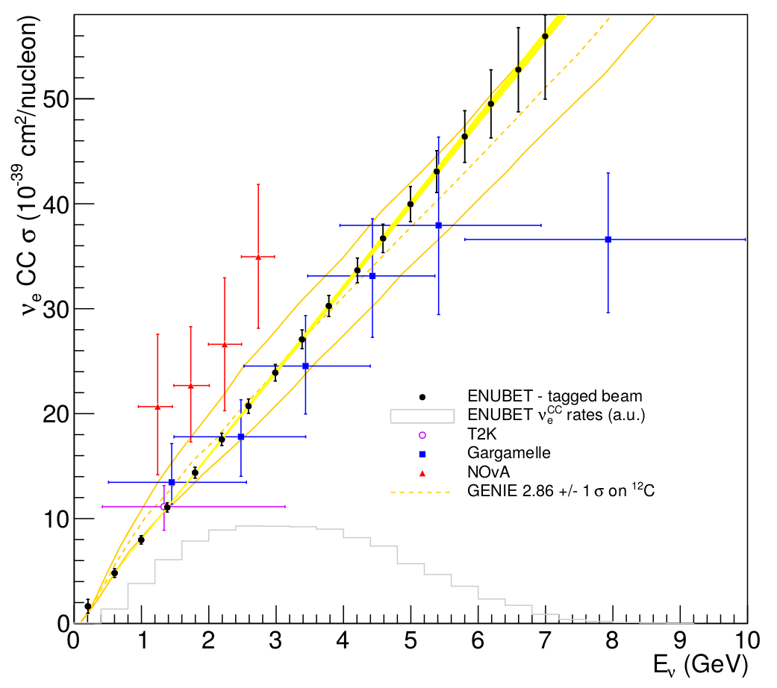
The ENUBET goals and program
NB. s(n_{e}) is to date a “green field”
Demonstrate experimentally that a new-concept n_{e} source, with ´ 10 better precision is feasible
→ s(n_{e} ) 1% sys. + 1% overall stat. errors (10.000 events) in realistic terms
What's peculiar with ENUBET:
a compelling, new physics case: a beam design optimized for s(n_{e})
taking advantage of the progress in fast, cheap, radiation-hard detectors
ERC program: 2 pillars
e⁺ tagger prototype validated at test beams
a detailed design for the hadron beam-line
The complete picture to move to a full experiment
By-products
calorimetry → new low-cost, ultra-compact detectors
accelerator physics → novel extraction schemes for fixed-target, beam-dump exp.
Notes:
This innovative approach was put forward for the first time very recently in a paper that I wrote with few collaborators at the beginning of this year. With this specific setup, which is sketched here, it would be possible to collect a large and pure sample of charged current electron neutrinos in a moderately small detector within a few years of running. Let's now consider the technical challenges to be faced to achieve this.

Slide 6
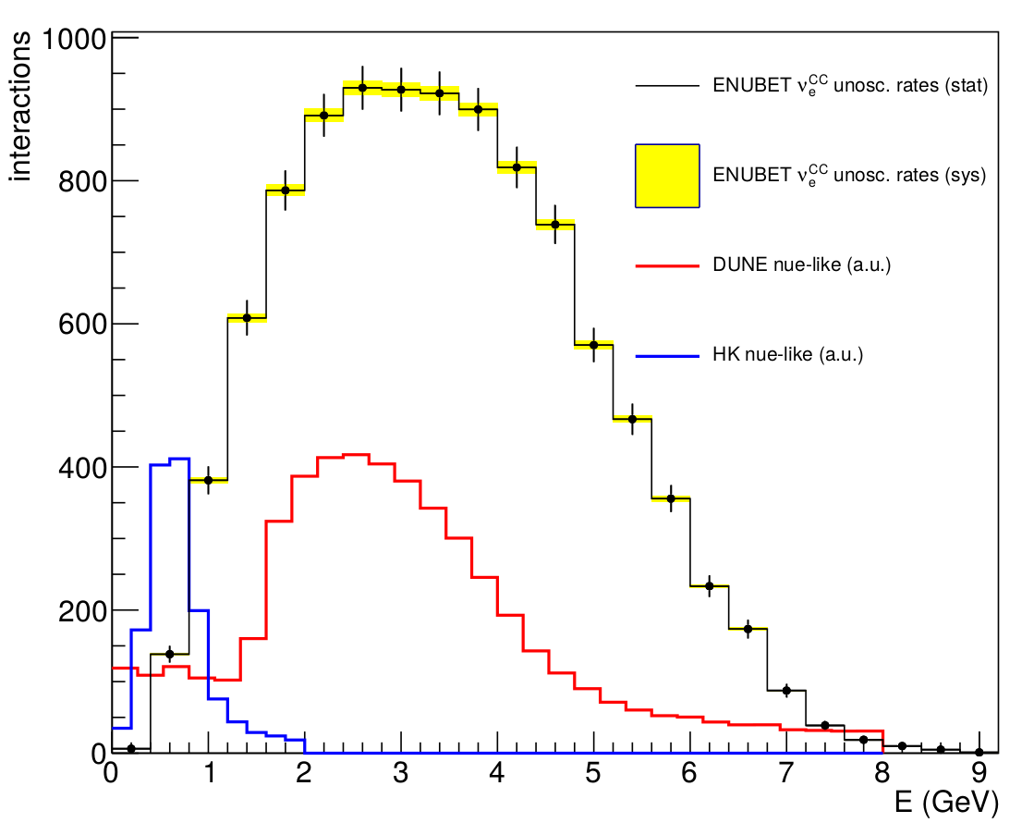
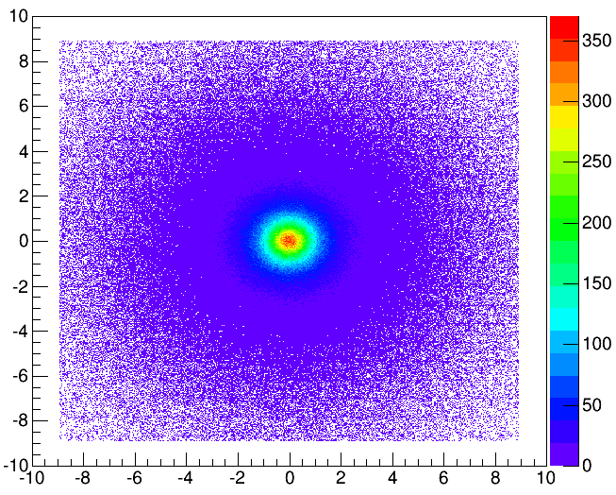
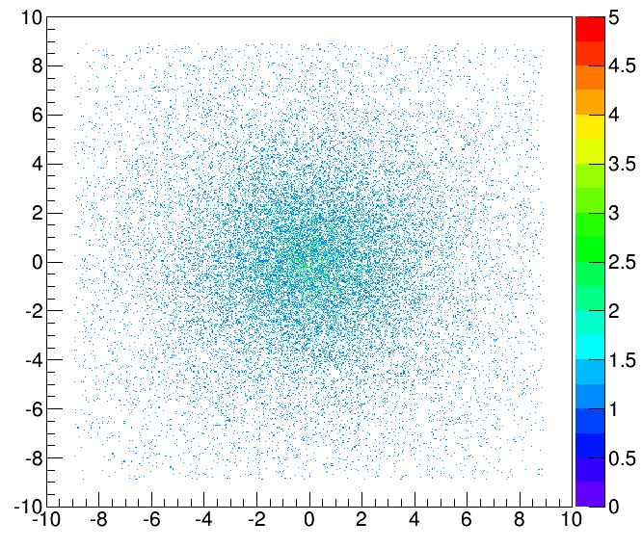
n detector and n_{e}^{CC} rates
<E> = 3 GeV, FWHM ~ 3.5 GeV
At 100 m from the hadron window
A 500 t mass (< ICARUS T600)
10⁴ ν_{e}^{CC}
Interesting region of long baseline future projects is covered
Further tuning foreseen to go even lower in energy preserving an acceptable positron purity (some ideas on the table)
tagger geometrical acceptance:
85% of n_{e}^{CC} with a tagged e⁺
(15 % in the forward ''hole'')
1.95 × 10¹³ K⁺/ν_{e}^{CC}
Radial profiles at the n detector
n_{m}
n_{e}
20 m

Slide 7
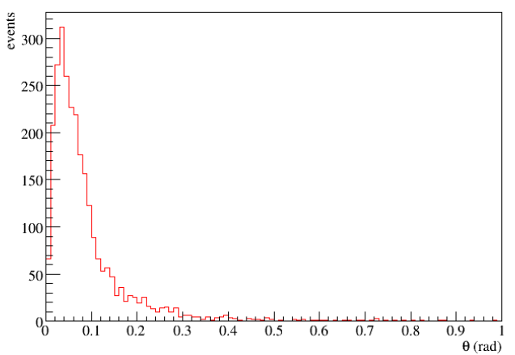
The golden channel: K⁺ → p⁰ e ⁺ n_{e}
Golden sample: good acceptance for e⁺ from K_{e3} thanks to the large emission angle (~ K mass)
L_{m} >> L(decay tunnel) n_{e,} ^{CC,DIF} ~ 3.3%
→ ~ all n_{e} are from K_{e3}
88 mrad
Angular distribution of e⁺ from K_{e3}
tagger
e⁺
D
U
M
P
K⁺
n_{e}
p⁰
g
g

Slide 8
Other K decays: silver channel
K decays are the only p source in the tagger → can be used with the K_{e3} “golden sample” to infer the n_{e} flux
GOLDEN f(n_{e}) ~ N(e⁺)/BR_{Ke3}
SILVER f(n_{e}) ~ N(p⁺)/BR_{K→ pX}
p^{+/0} from K⁺ can mimic an e⁺ and pollute the K_{e3} golden sample
→ must be discriminated:
  1) calorimetric rejection using longitudinal energy profile
  2) tagging vertices w. timing:
  σ_{t} O(100 ps) ~ σ_{zVTX} O(1m) veto π⁺ from the decay vertex rejects fake e⁺ from K⁺ → π⁺π⁻π⁺ and K⁺ → π⁺π⁰
m⁺
K⁺
n_{m}
63 %
m⁺
K⁺
p⁰
n_{m}
3.2%
g
g
p⁺
K⁺
21 %
p⁰
g
g
p⁺
K⁺
p⁻
6 %
p⁺
p⁰
g
g
K⁺
2 %
p⁺
g
g

Slide 9
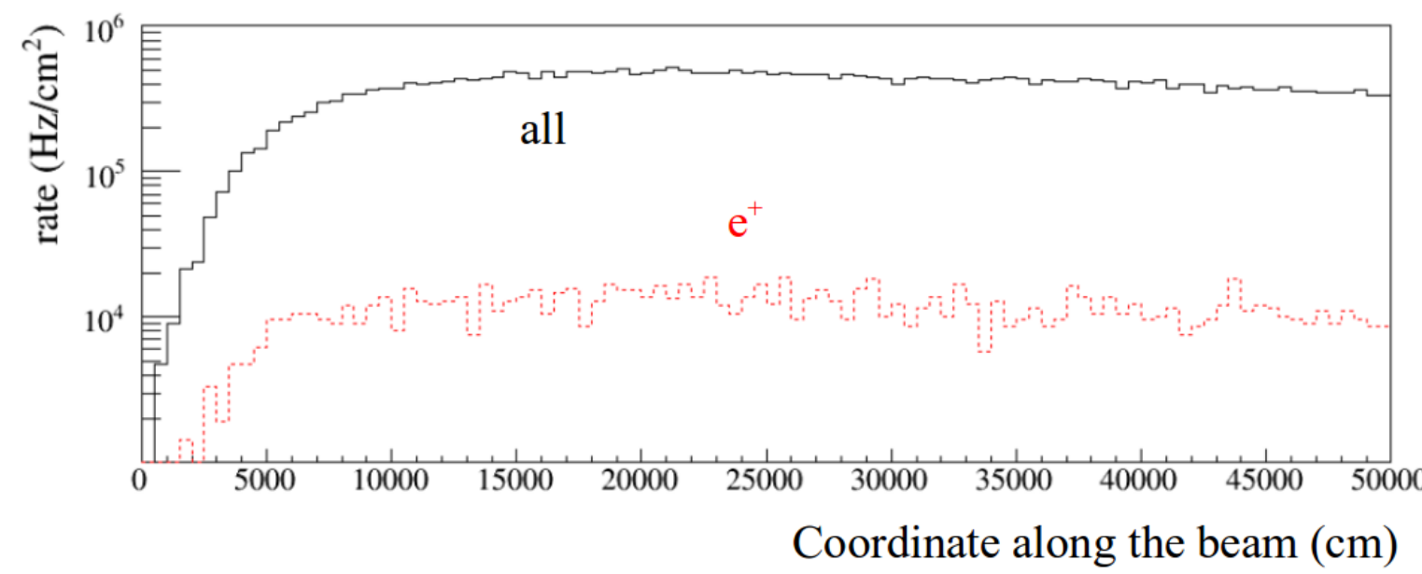
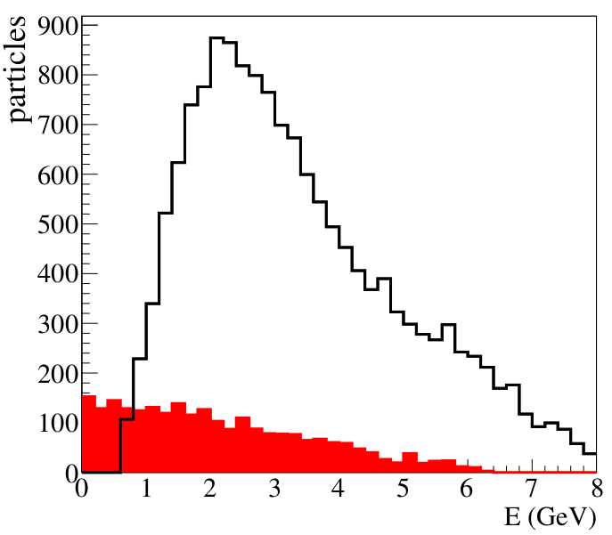
The e⁺ tagger challenges
Injecting 10¹⁰ p⁺ in a 2 ms spill →
 | Max rate (kHz/cm²)
μ⁺ | 190
γ | 190
π⁺ | 100
e⁺ | 20
all | 500
(m⁺, g, p⁺, e⁺)
The decay tunnel: a harsh environment
particle rates: > 200 kHz/cm²
backgrounds: pions from K⁺ decays
A. Longhin et al. EPJ. C (2015) 75:155
p⁺ background
Need to veto 98-99 % of them
Moreover:
extended source of ~ 50 m
grazing incidence
significant spread in the initial direction
e⁺signal
Notes:
The decay tunnel of a neutrino beam is a harsh environment. In the past it was believed that particle tagging inside the tunnel was out or reach for any available technology. Fortunatly the positrons that ENUBET wants to tag and that originates from the decay in flight of the kaons are produced at large angles. As a consequence, if we instrument only the outer cylinder of the tunnel, most of the particles will cross the tunnel and reach the beam dump without hitting the positron tagging instrumentation. Still, even at those angles the particle rates are large and often exceed 200 kHz/cm2. In additions, positrons are not the only particles that are produced by kaon decays: the decay tunnel is rich of charged and neutral pions, which constitute a potential background for the positron detectors. We therefore need an instrumentation that is able to reject 99% of the photons and 98% of the charged pions. Finally, it is worth noticing that the length of the decay tunnel is of the order of 50 m. ENUBET needs a technology that is really cost-effective and that can be scaled up to such lengths.

Slide 10
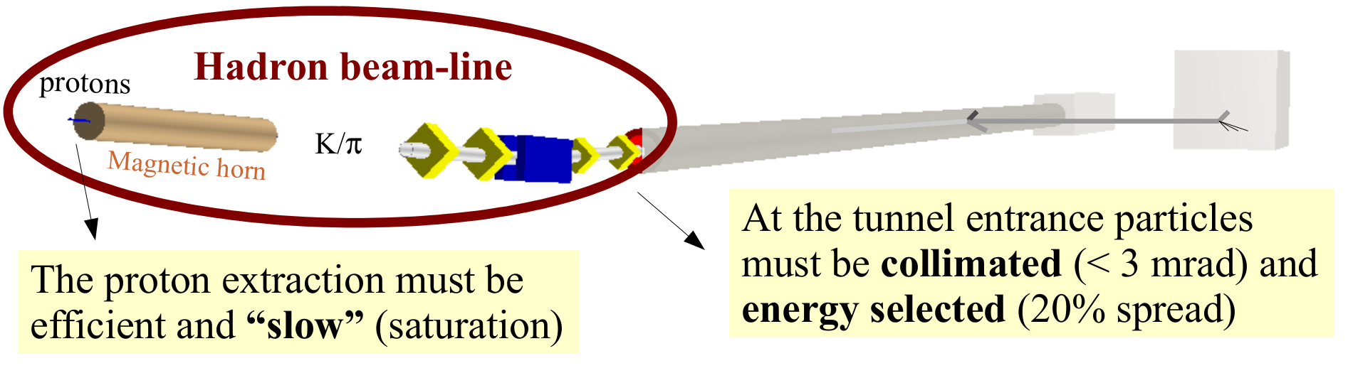
The hadron beam-line challenge
Short transport line to prevent early decays
Focusing system
Proton extraction from accelerator
Unconventional: many (10⁸), short (2 ms) pulses with few protons (< 3 ´ 10¹¹)
A: pulsed device (magnetic horn)
Scenarios
B: static devices (DC magnets)
  O(1s) long slow extractions
Notes:
The active instrumentation of the decay tunnel can work at the desired level of precision only with a dedicated design for the hadron beam-line. Such design is a very important part of the ENUBET project and, again, the solutions developed have a significant impact on accelerator science. Unlike conventional neutrino beams, the focusing and transport line must inject particles at the entrance of the tunnel with an opening angle not larger than 3 mrad and a 20% spread in momentum. However, the most important issue is to develop a slow but efficient proton extraction scheme in order to keep the particle rates in the decay tunnel at a level that is sustainable by the positron detectors. In ENUBET we propose a very innovative extraction scheme that is based on standard magnetic horns and a new multi-herz resonant slow extraction. Employing this scheme, we can get a high number of short and low intensity proton bunches even if the repetition rate of the accelerator is very small. The second option that our team will investigate is even more intriguing: to diliute the proton extraction up to 1 second using a purely static focusing system. The main advantage of this option is that the particle rate would be so small that we could correlate in time and therefore associate on an event by event basis the observation of the neutrino in the detector with the observation of the positron in the decay tunnel (fai il mimo con le mani). This facility would be the first realization of the famous “tagged neutrino beam” that Bruno Pontecorvo proposed in the 70’s: a fantastic tool for neutrino physics but, as you can imagine, completely out of reach for the technology of the 20th century.

Slide 11
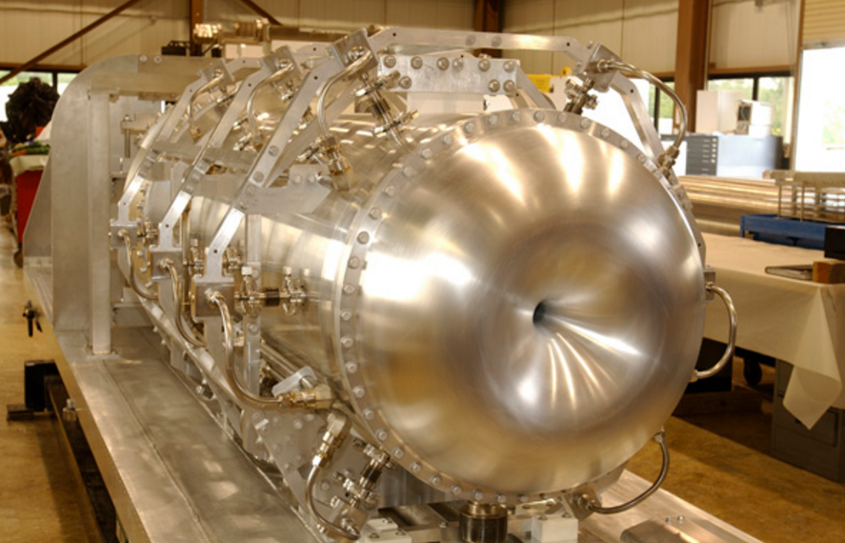
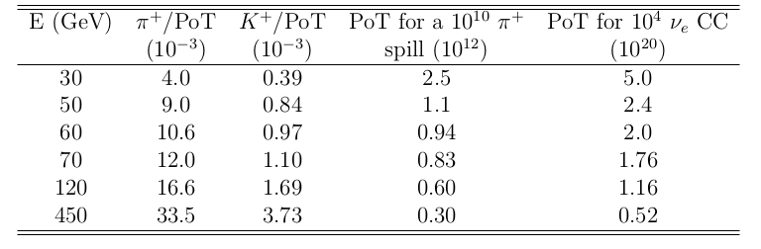
Hadron beam-line: scenario A
Magnetic horns. Good collection. Pulsed devices.
t_{impulse} < 10 ms (Joule heating, I ~ O(100) kA)
tagger rate limit: 10¹⁰ π⁺ in 2 ms ~ (collection eff.) 0.3-2.5 × 10¹² PoT/spill depending on E_{p}
* J-PARC > 1.5 x 10²¹ PoT
CNGS = 1.8 x 10²⁰ PoT
NuMI = 1.1 x 10²¹ PoT
Simple
conversion
Simple
conversion
1.94 × 10¹³ K⁺ / ν_{e}^{CC}
PoT to get 10⁴ ν_{e}^{CC}: 0.5-5 × 10²⁰ OK with present acc. performances!
Number of spills: ~ 2 × 10⁸. More challenging:
  R&D multi-Hz slow resonant extraction (machine studies), horn

Slide 12
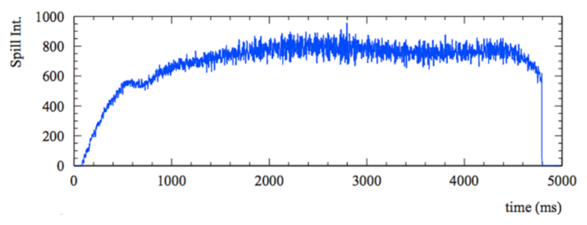
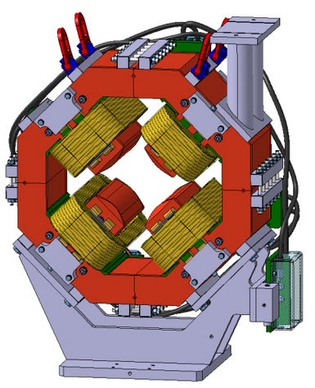
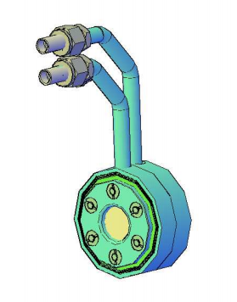
Hadron beam-line: scenario B
Static focusing: large aperture radiation-hard quadrupoles.
Disadvantage: loss of acceptance w.r.t. horn-based focusing.
  PoT to get 10⁴ ν_{e}^{CC}: 0.5-7 × 10²¹ O(~10 ×) more but still feasible. Can be compensated by (data taking x detector mass)
  Far from tagger maximal rates
  R&D on static focusing beam-line to maximize the collection efficiency (~ increase “useful” hadrons/PoT).
  the single resonant slow extraction over O(s) times is less challenging than the multi-Hz version. Sinergies with the needs of SHiP proposal at CERN.
SHiP: arXiv:1504.04956

Slide 13
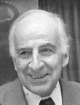
Scenario B: ''time tagging'' !
Event time dilution → Time-tagging
Associating a single neutrino interaction to a tagged e⁺ with a
small “accidental coincidence” probability through time coincidences
E_{ν} and flavor of the neutrino know ''a priori'' event by event.
Superior purity. Combine E_{ν} from decay with the one deduced from the interaction.
e⁺
ν_{e}^{CC}
Time coincidence of
ν_{e}^{CC} and e⁺ |δt - Δ/c| < δ
δ = combined t-resolution (e⁺ tagger and n detector)
D
Accidental tag probability: A ~ 2 ´ 10⁷ d/T_{extr}
T_{extr}= 1s (~ 1 observed e⁺ / 30 ns) + δ = 1 ns → A = 2 % OK !
N.B. horn focusing (scenario A) is not viable if we are interested in time-tagging.
T_{extr} = 2 ms (1 e⁺ / 70 ps) even δ = 50 ps gives A = 50%.

Slide 14
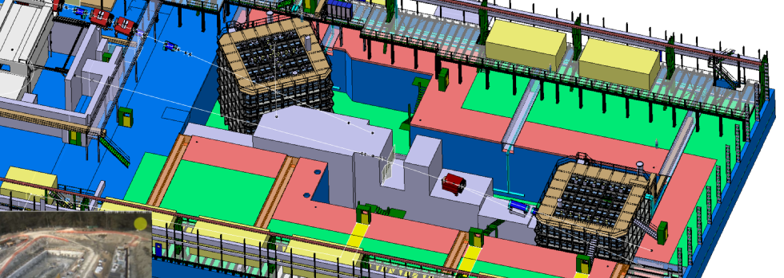
Beyond cross sections: time tagging
Proving a tagged neutrino beam for cross-sections is ENUBET's
primary goal (“monitored beam”). Test beam activities based at the CERN-PS East area.
In the last phase of the project
time synchronization could be
tested at the EHN1 CERN neutrino
platform:
beam halo m / cosmic rays
ENUBET tagger prototype ↔ LAr (WA105, proto-DUNE w. scint. light)
or WCh prototypes
Tagger-detector sync. << ns → OK (direct optical links)
s_{t} of the tagger < 1 ns → OK
s_{t} of the n detector < 1 ns → at the limit of present technology
Cosmic background ´10 → Foresee overburdens
small K⁺ momentum bite small → can imply flux reduction
(not to spoil the n_{e} energy reco.)
For a final experiment

Slide 15
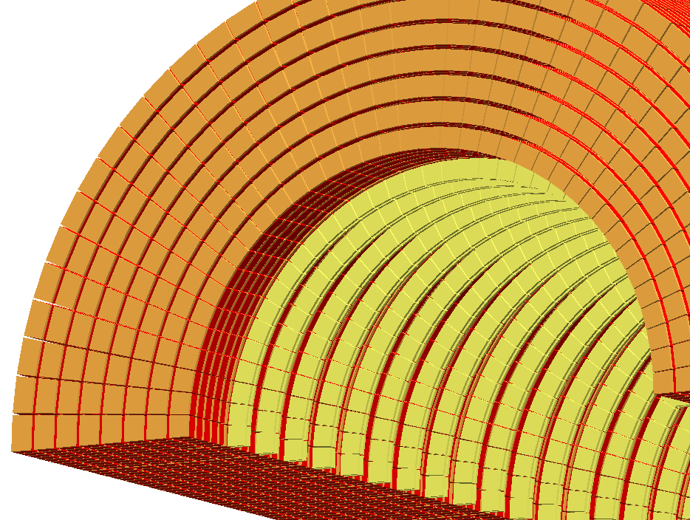
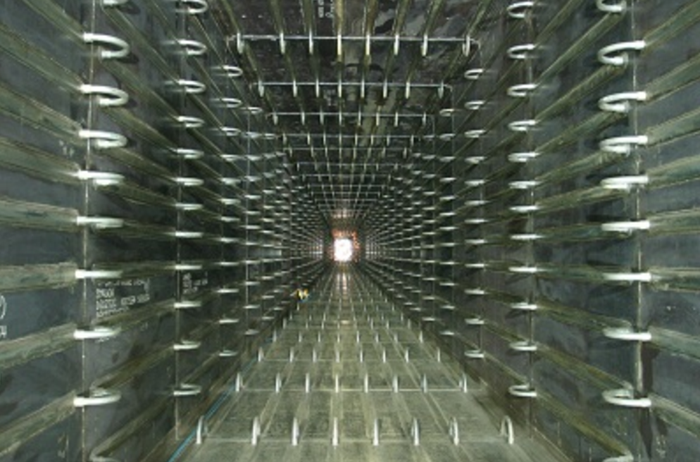
e⁺ tagger design
1) compact calorimeter with
longitudinal segmentation
2) integrated g-veto
e⁺
Conventional beam-pipe replaced by active instrumentation →
K⁺
UCM
n_{e}
p⁰
→ p± rejection
1) Calorimeter (“shashlik”)
  Ultra-Compact Module (UCM)
Detector R&D activities
2) Integrated g -veto
  plastic scintillators or
  large-area fast avalanche photodiodes
  other fast detectors options
→ p⁰ rejection
Notes:
The solution to these challenges reside in the exploitation of novel ultra-compact calorimeters with longitudinal segmentation and an integrated veto system. This calorimeter completely replace the beam-pipe of conventional decay tunnes. The longitudinal segmentation of the calorimeter allows for the separation of positrons from charged pions because the showers produced by hadrons are much longer than electromagnetic showers. The key for the success of this approach is to devise a low cost and compact light readout system, which is by itself a major advance in particle calorimetry. Similarly, the key feature of the photon veto is the replacement of complex light transport systems with a device that integrates the sensitive detector and the readout interface. As a consequence, ENUBET also develops a rich R&D program with a potential deep impact on experimental particle physics as a whole and not only neutrino physics.

Slide 16
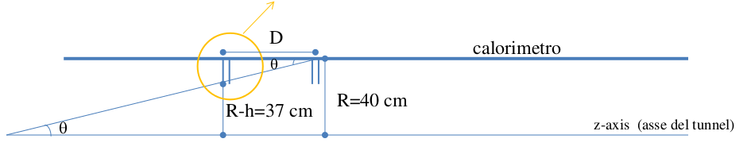
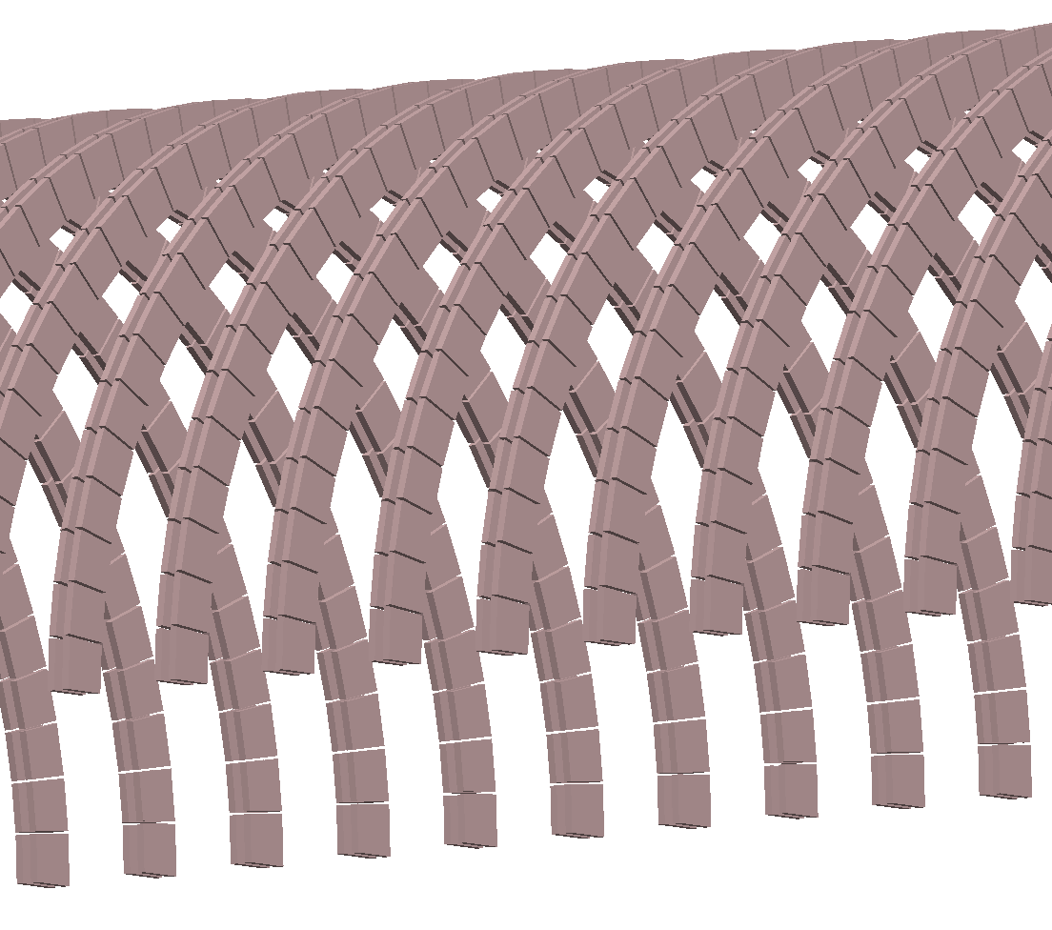
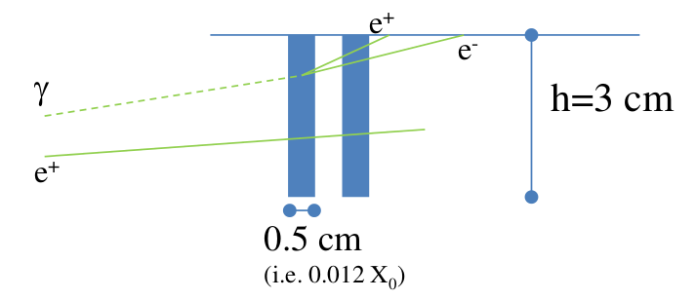
The photon-veto baseline option
Background from g conversions from p⁰ emitted mainly in K_{e2} decays (K⁺ → p⁺ p⁰)
= 7 cm
All particles will intercept at least one doublet
A positron on average will cross 5 doublets
Exploit 1 mip – 2 mip separation
Possible alternative/attractive solutions under scrutiny allowing a reduced material budget and superior timing.
Test beams at Frascati: electronics response at high rates and low-E e⁺,1 mip/2 mip

Slide 17
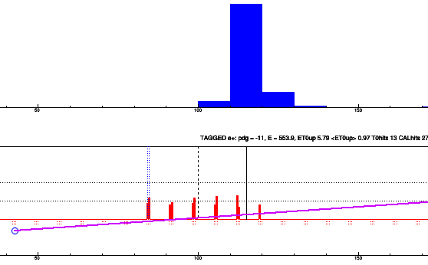
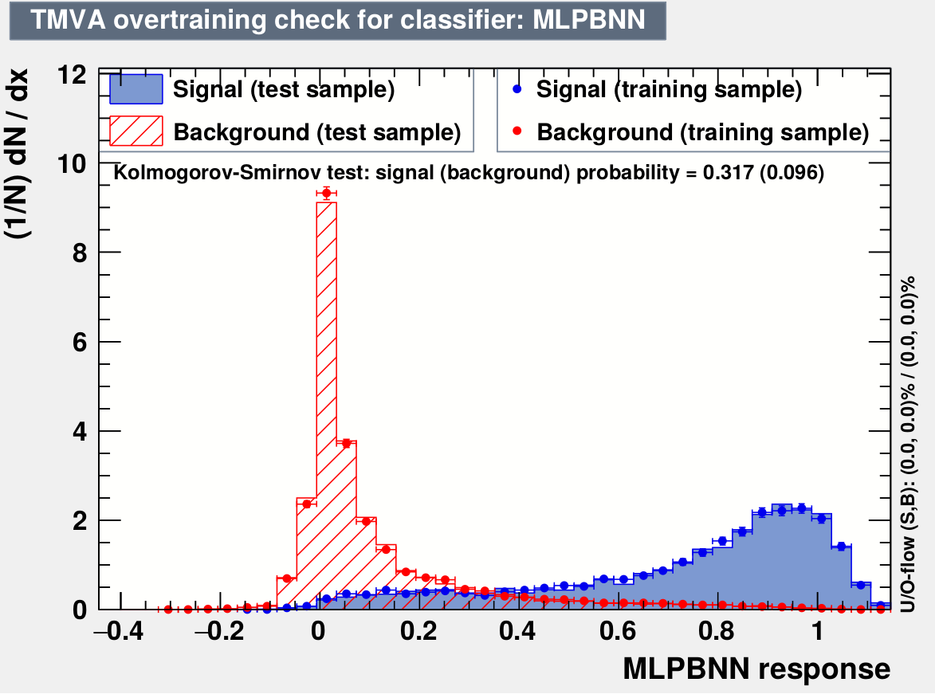
e/p separation studies
inner e.m. layer
GEANT4 simulation.
Reject simultaneously p⁺ and p⁰
Takes into account pile-up related restrictions in the event building.
TMVA multivariate analysis:
E released in calorimeter
• E in photon-veto doublets (3 layers).
• DZ between inner e.m. layer peak and the 1st photon-veto doublet.
• N. photon veto doublets upstream of the inner e.m. layer peak
photon veto
doublets
 | e_{geom} | e_{sel}
e⁺ | 90.7 % | 49.0 %
p⁺ | 85.7 % | 2.9 %
p⁰ | 95.1 % | 1.2 %
Early results confirm previous estimates from parametrizations

Slide 18
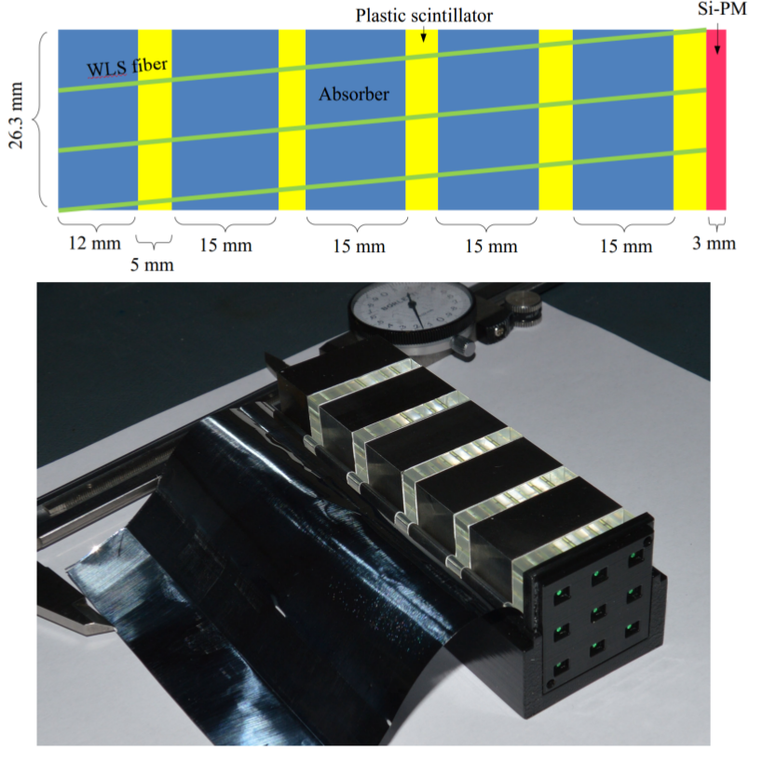
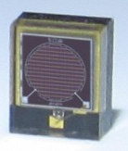
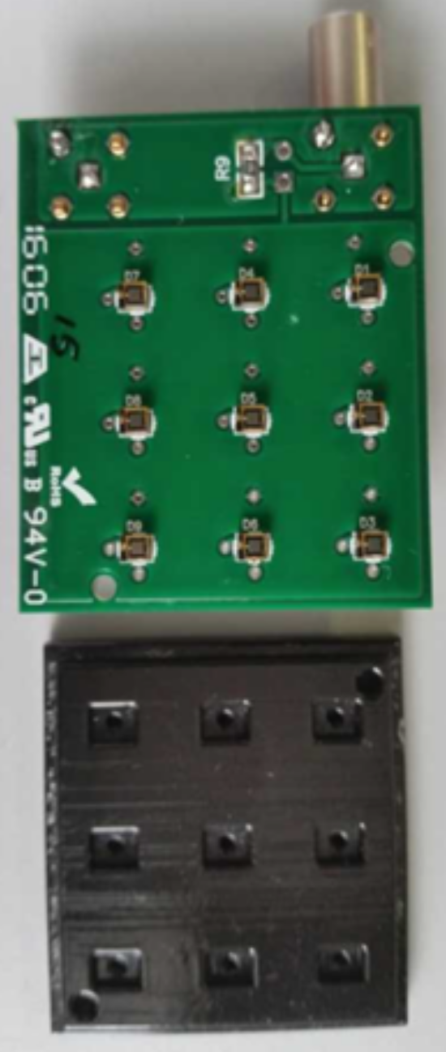
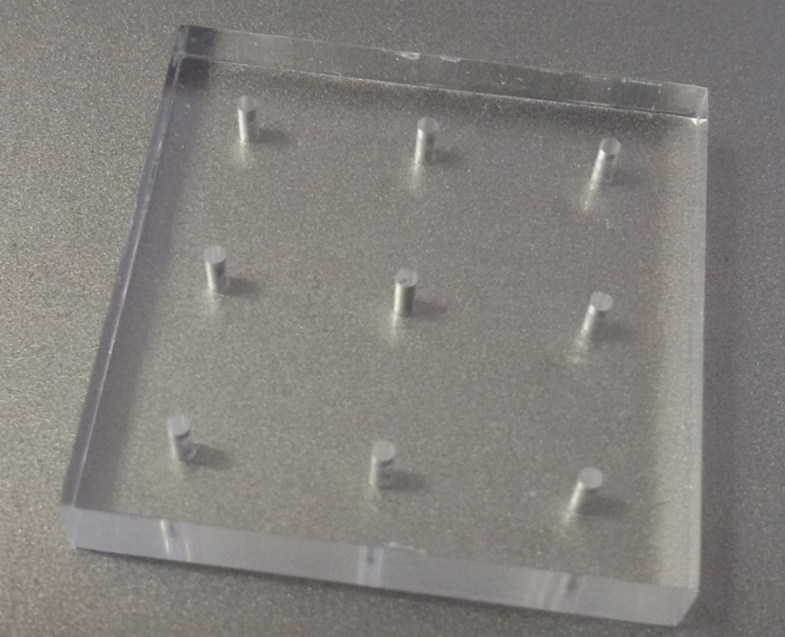
The Ultra Compact Module (UCM)
Iron
1 Si-PM
1 WLS
spring 2016
prototypes

Slide 19
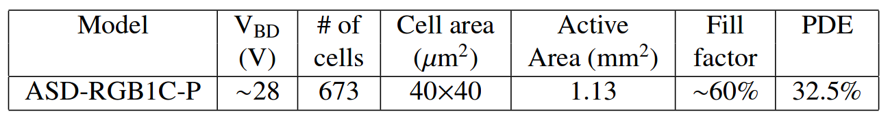
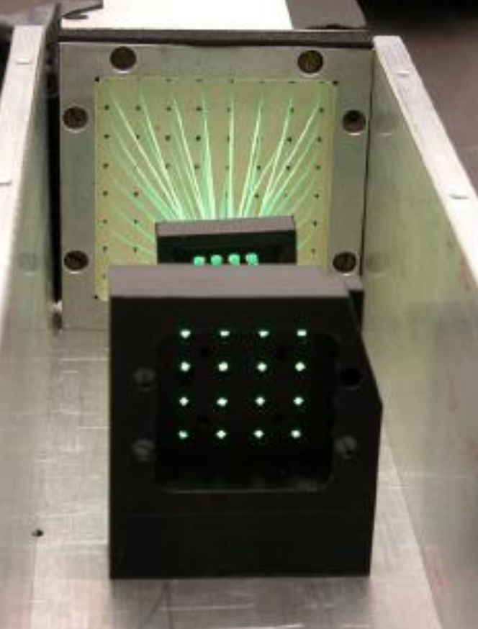
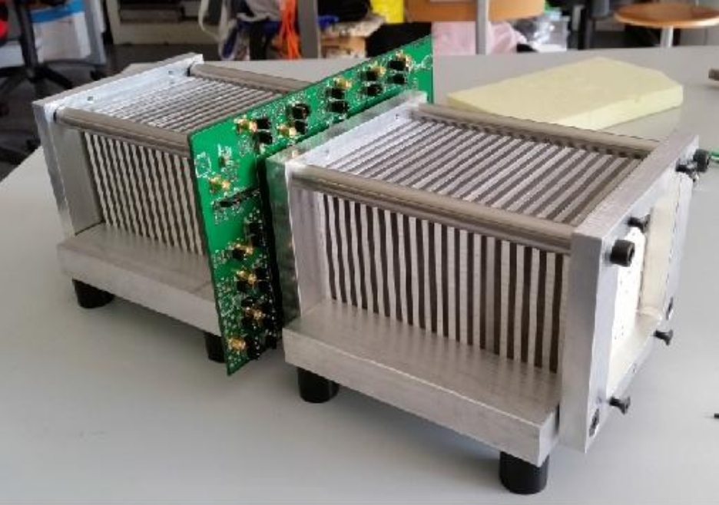
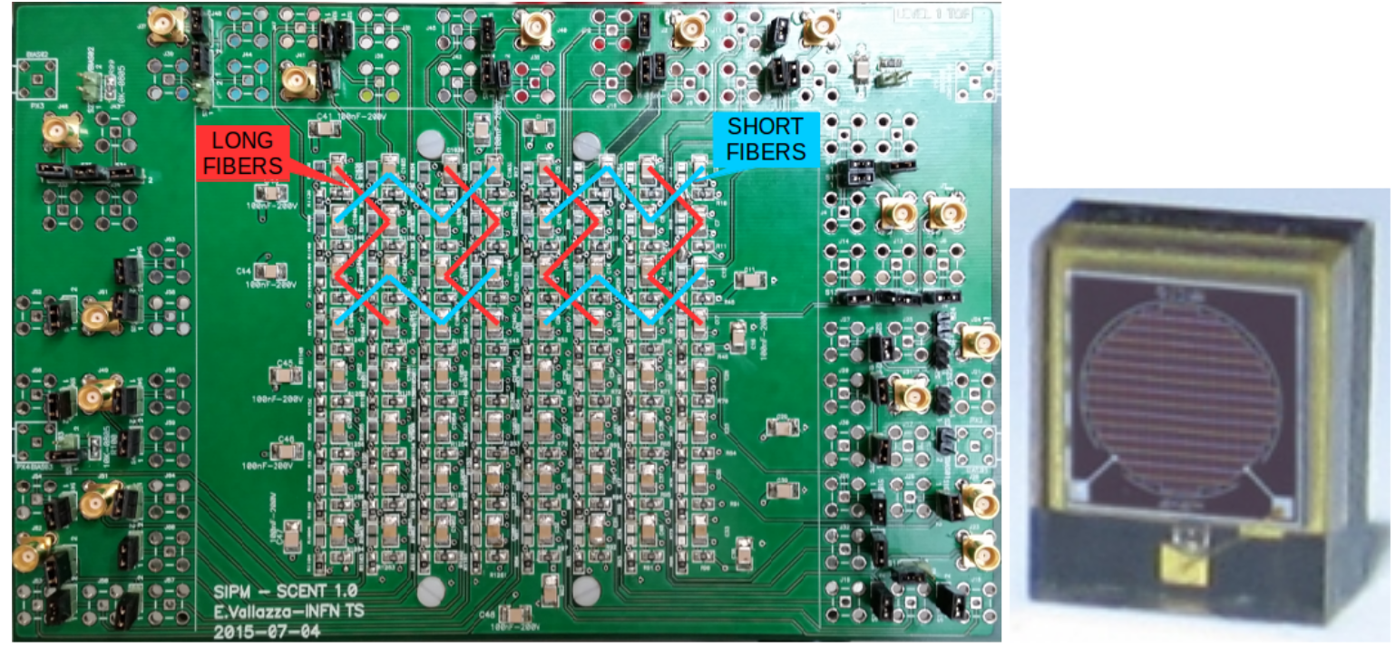
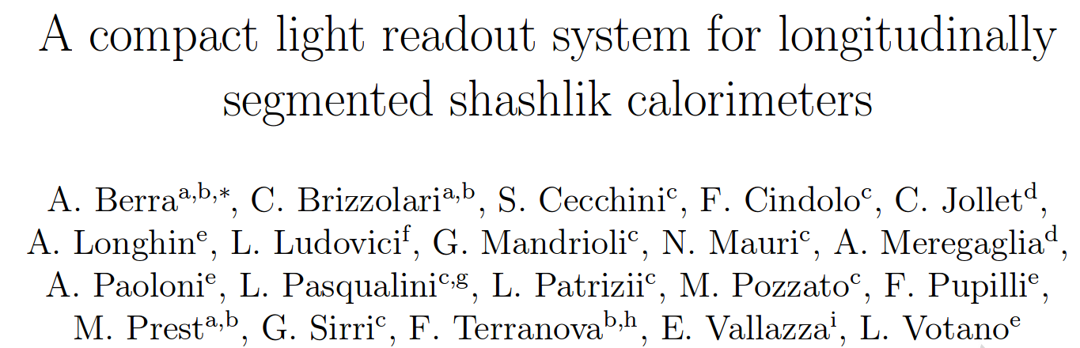
Tagger detector R&D: SCENTT
Shashlik Calorimeters for Electron Neutrino Tagging and Tracing
A. Berra, C. Jollet, A. Longhin, L. Ludovici, L. Patrizii, M. Prest, A. Meregaglia, G. Sirri, F. Terranova, E. Vallazza
INFN (CSN5) activity on shashlik calorimetry for neutrino applications started last year (MiB-Insubria, TS, BO, LNF. R.N. F. Terranova)
First tests at CERN PS-T9 (Aug. 2015) of a shashlik calorimeter with WLS fibers coupled directly to individual SiPMs
Results recently published in N.I.M. A
Resolution vs E and e/p separation in line with simulation. Done both using TDC or digitizers. No nuclear counter effects.
http://dx.doi.org/10.1016/j.nima.2016.05.123 ArXiv:1605:09630
Notes:
The basic unit of the ENUBET calorimeter is a compact module made of iron and organic scintillators tiles. The light produced by the scintillators is collected by optical fibers doped with wavelength shifters that run through the tiles. The frequency of the photons is therefore shifted from the near ultraviolet and blue to green. It matches perfectly the spectral response of the silicon photomultiplier that are positioned in a vetronite holder just at the back of each fiber. The module is compact and completely standalone because the electrical signal that is proportional to the photon yield can be extracted directly from the holder. This solution is grounded on the outstanding progress made in solid state photosensors in the last five years and, at the same time, is extremely innovative because it removes any intrinsic limit on the possibility of segmenting longitudinally this type of calorimeters.

Slide 20
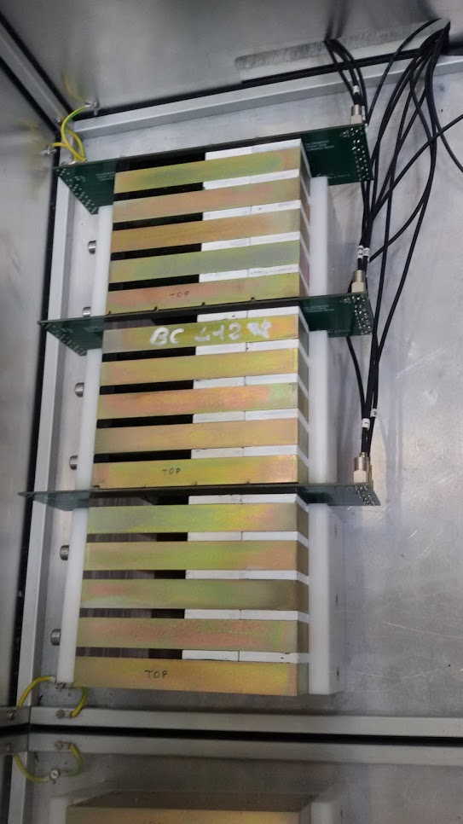
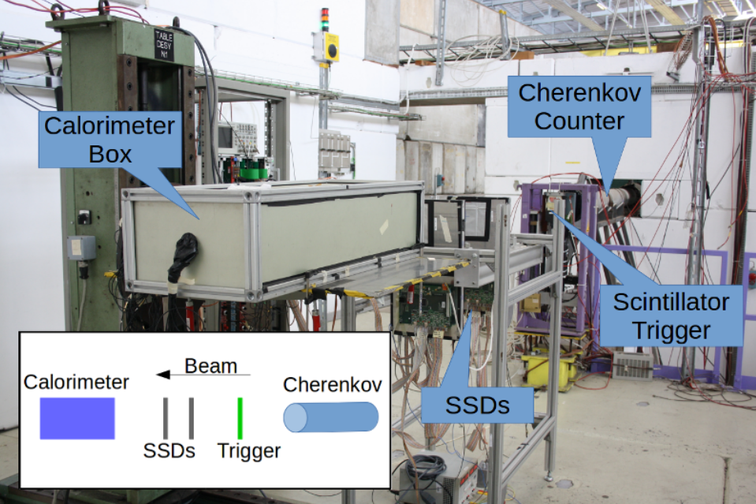
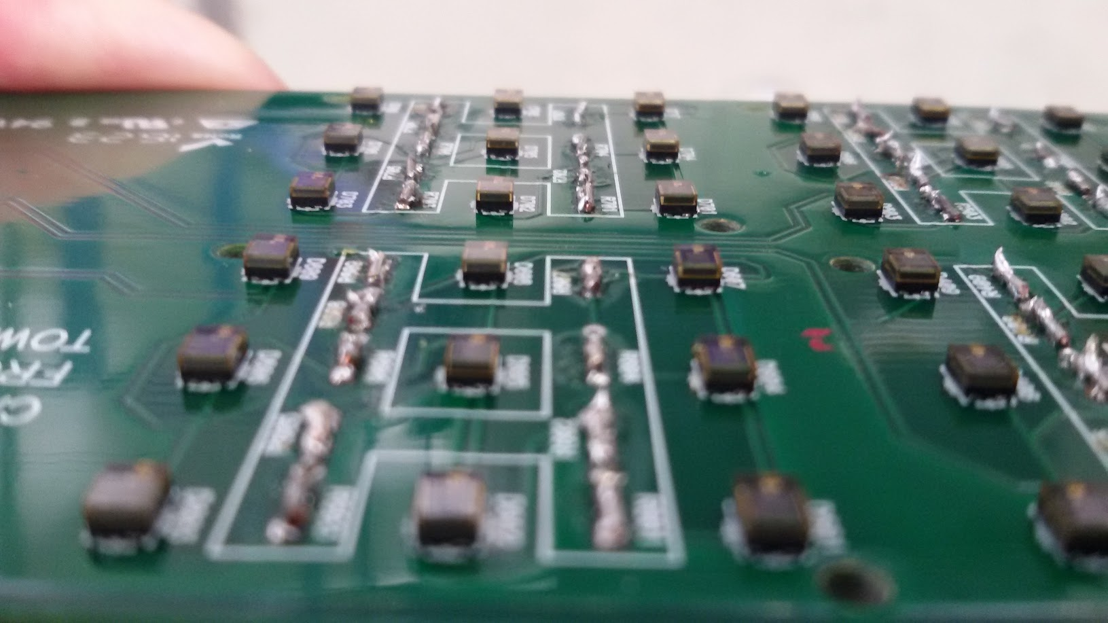
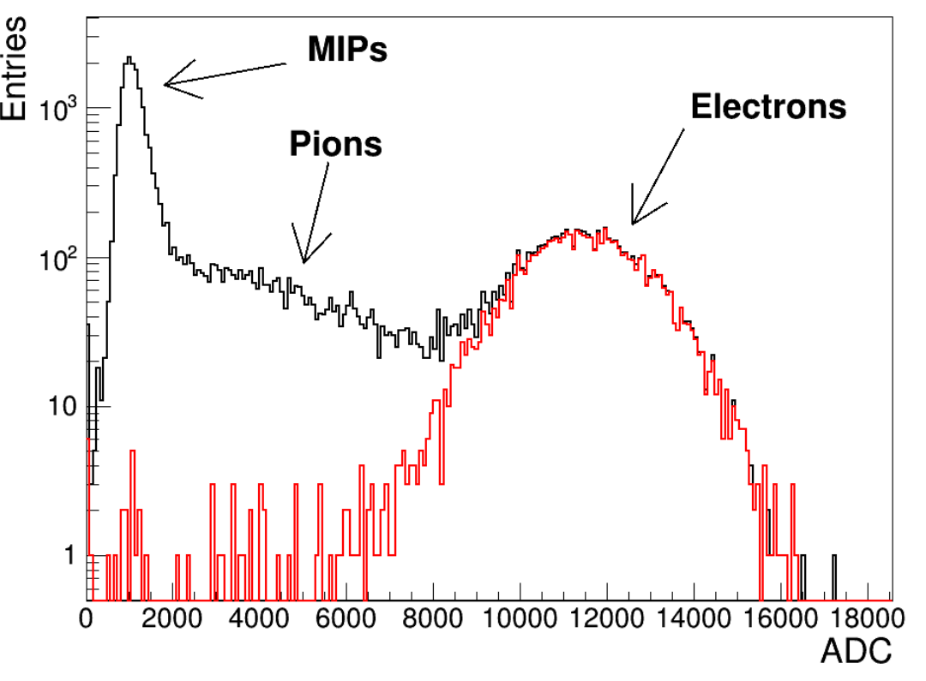
July 2016 CERN-PS T9 test beam
29-06 → 12/07/2016
First (successful) tests of 12 ENUBET UCM modules (12 X₀) with pions and electron beams from 1-5 GeV. HD Si-PM with 20 mm cell size.
No dead zones,
uniform long. sampling

Slide 21
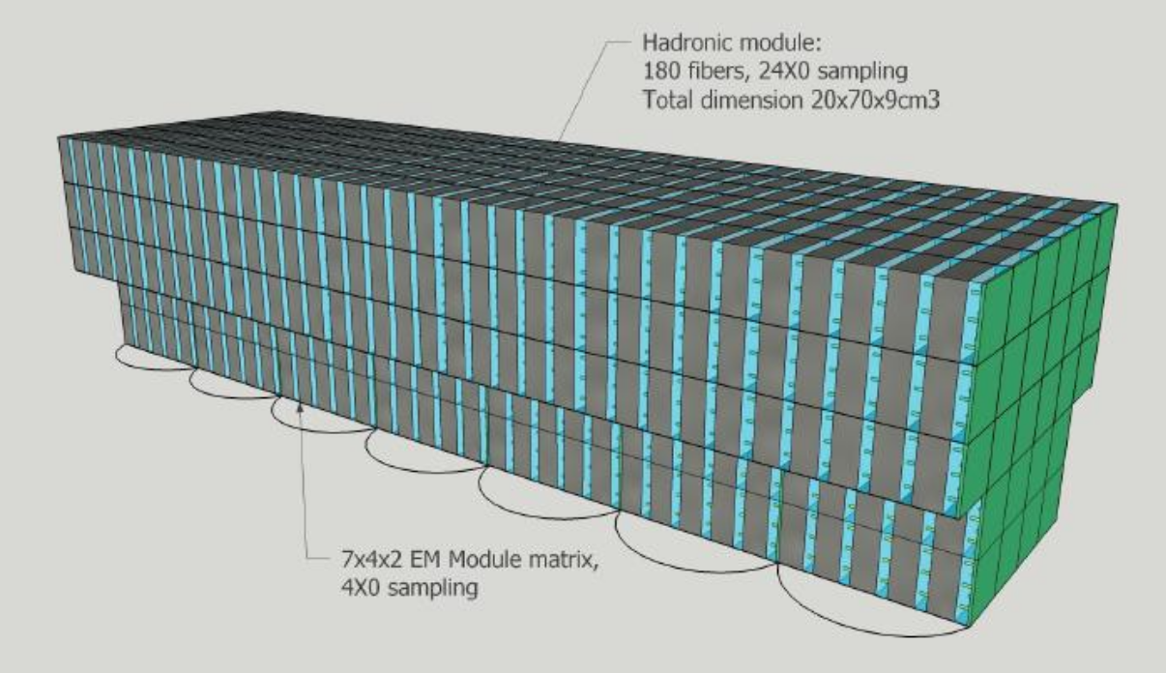
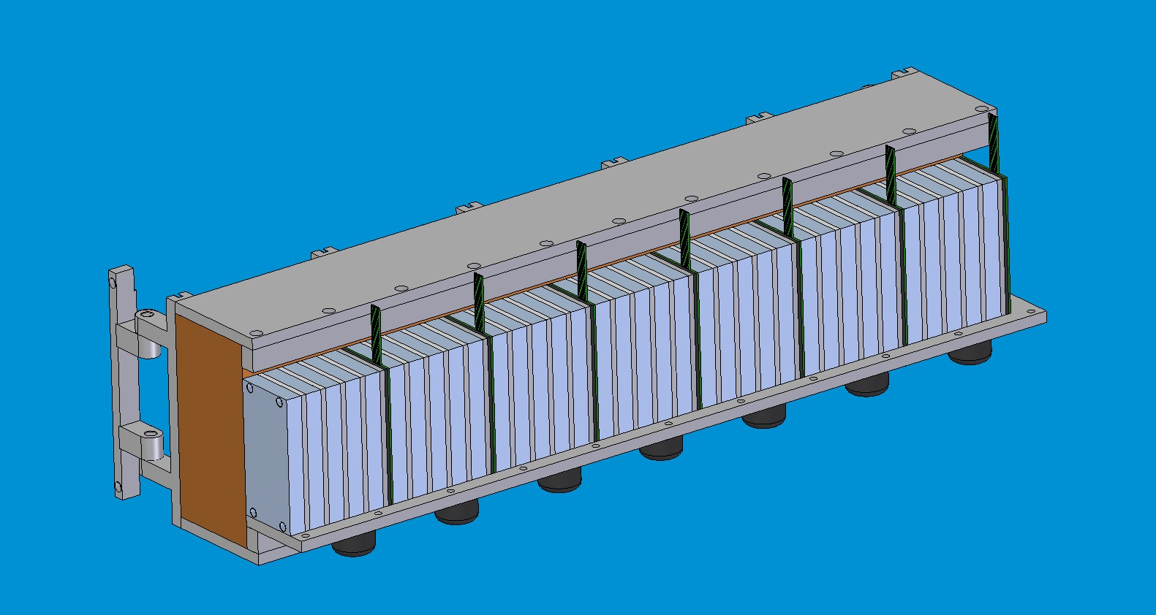
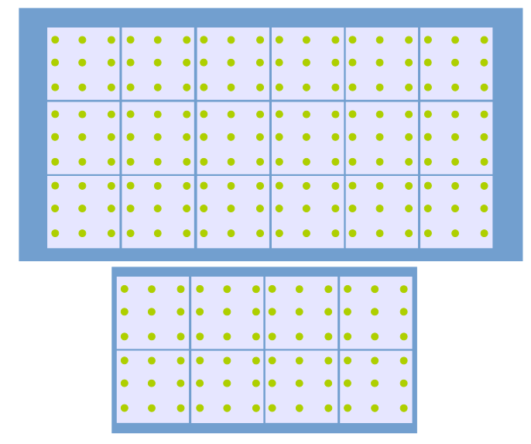
Next test beam at CERN-PS T9
Planned for November 2016:
Inner + outer modules →
readout w. custom fast digitizers
Orientable cradle to study grazing
Incidence.
70 cm

Slide 22
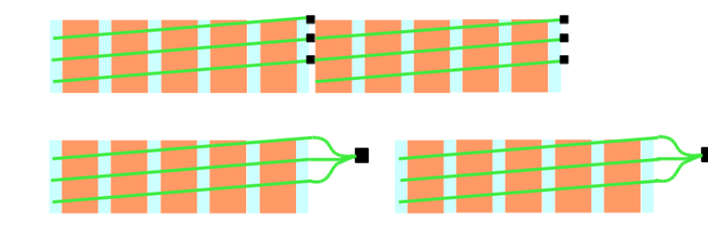
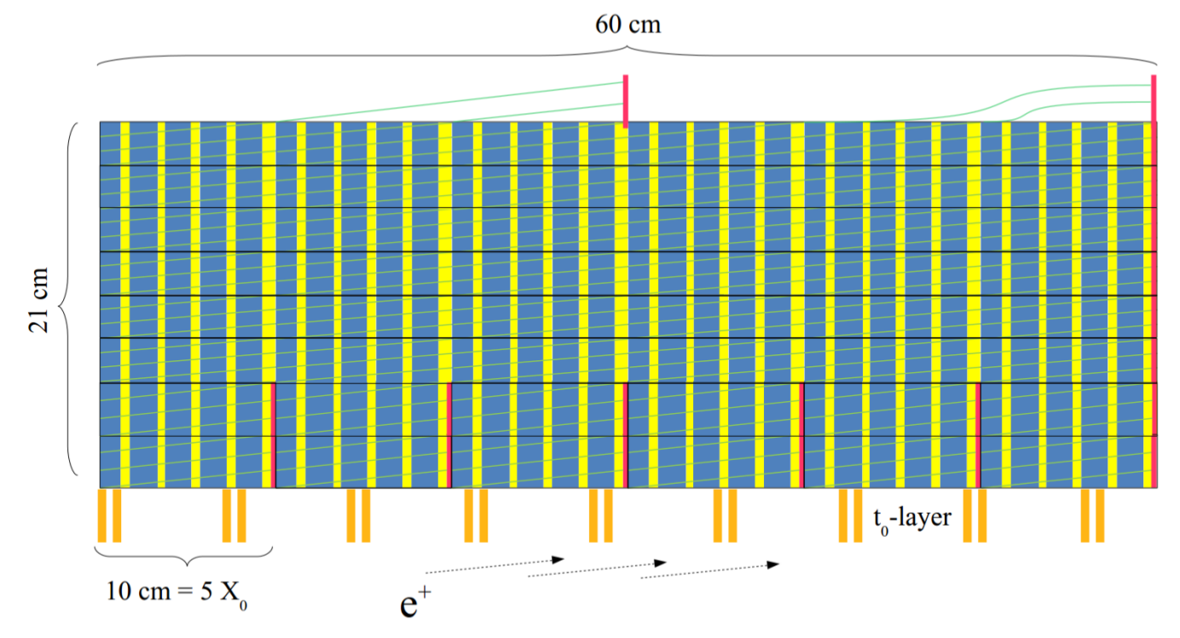
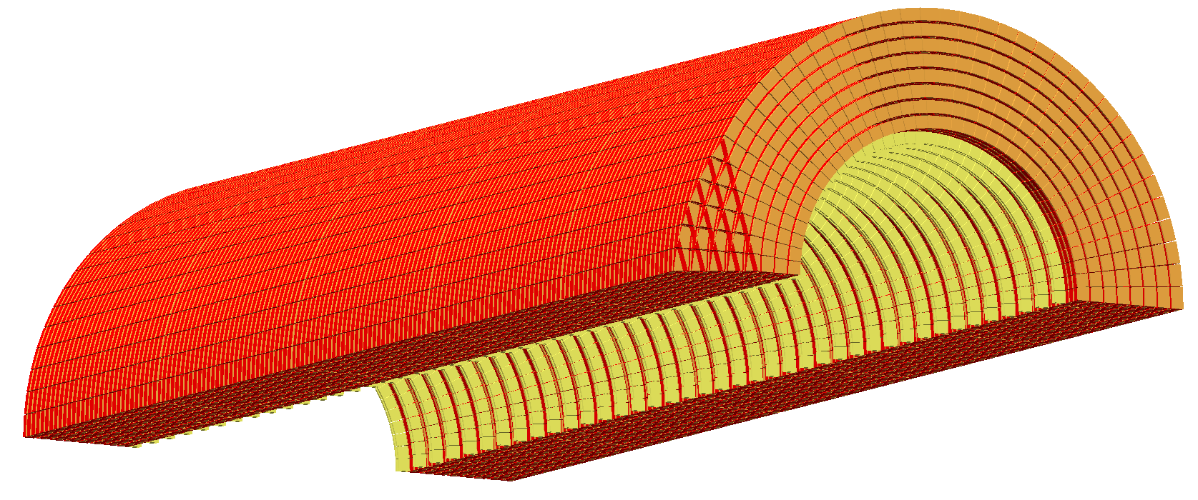
The final prototype
1 super-module
SiPM + PCB
Outer modules
Inner modules
5 super-modules
Dimensions: 3 m ´ p
# SiPM: 34000
Channels: 3800
Weight: ~ 5 t
WLS fiber length: ~10000 m
Readout: custom waveform digitizers,
  2 ns granularity over ~10 ms

Slide 23
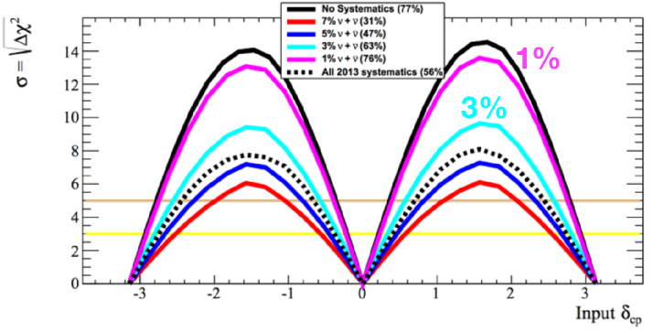
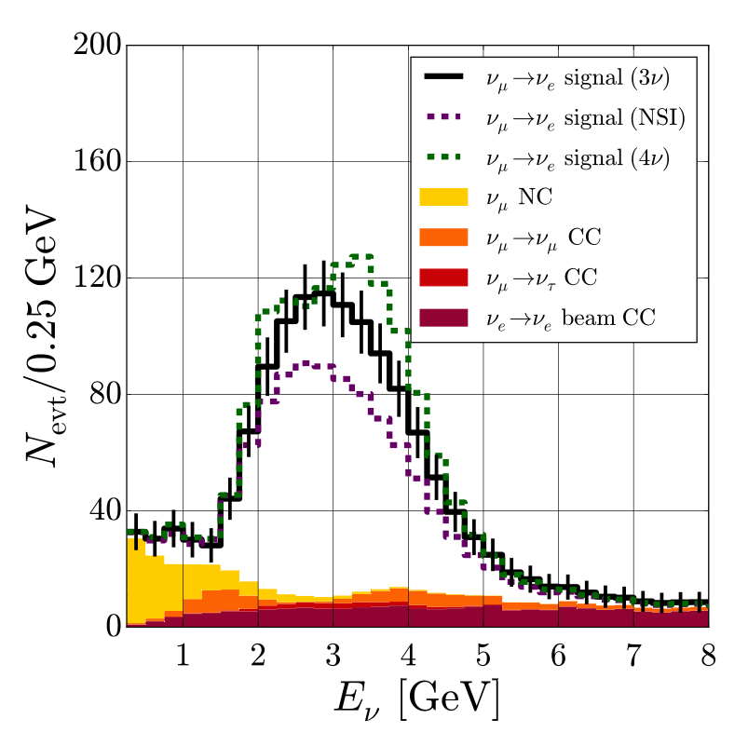
Possible sinergies of our programs (I)
The “natural” one:
HK
Sensitivity study for CPV for HK
s(n_{e}) and s(n_{e} ): uncorrelated normalizations
parameters with {0, 1, 3, 5, 7 %} uncertainties
M. Hartz @ NuFact 2015
The systematic uncertainty should be controlled to < 1-2% to minimize the impact on the CPV discovery sensitivity. Probe smaller and smaller values of sind_{CP}
7%
De Gouvea et al., 1605.0937
3+1 n
Exotic (sterile neutrinos, non-standard interactions): a similar phenomenology
→ a precise knowledge of s(n_{e}) vs E is needed to get a deeper insight of the underlying physics.
DUNE
NSI

Slide 24
Possible sinergies of our programs (II)
The ENUBET tagger could be coupled with a WCh detector (time coincidences tests with prototypes or even eventually for the final experiment).
The ENUBET beam-line study is intended to be site-independent. → study extraction schemes opportunities at J-PARC (fast rep. rate!) and proton economics.
Large area fast ps detectors for Cherenkov light detection for the photon veto would allow superior timing and improve p rejection at low energies (relevant for Hyper-K) using timing-based vertexing. → To be studied!
Large area fast ps detectors also for the neutrino detector (+ static focusing) would open the doors to real time tagging.

Slide 25
Resources, institutions
Project started on 1 June 2016 (5 y duration)
Other direct 10 %
Kick-off meeting (Padova, 23-24 June 2016): https://agenda.infn.it/conferenceDisplay.py?confId=11574
e⁺ tagger
43 %
Travel 8 %
2 MEUR budget
Personnel
38 %
Team:
  expertise in calorimetry, accelerator and n physics.
INFN Padova, Mi-Bicocca-Insubria, Rome1, LNF, Trieste, Bologna, Bari, Naples.
CERN-ABT (beam extraction)/STI (targetry, focusing), IN2P3 Strasbourg.
Interest from FBK, Trento (Si-PM R&D).
Budget
~ 35 people currently interested to an Expression of Interest planned for submission to CERN-SPSC this autumn. Allow official commitment of CERN collaborators, support for beam test campaigns. Visibility. Possibility for CERN NP.
Available upon request for interested colleagues!

Slide 26
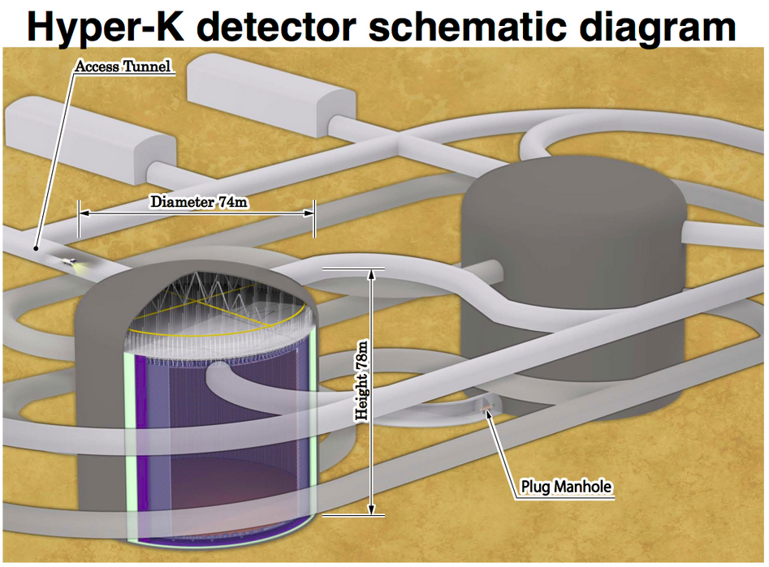
Conclusions
ENUBET, HK: many potential synergies:
    systematics reduction for precision oscillation physics:
      CP violation and standard parameters
      non-standard scenarios (NSI, sterile neutrino searches)
    R&D for large area ps detectors
      fast timing in the decay tunnel (background reduction)
      fast neutrino detectors (time tagged neutrino beams)
Fore more information a draft for an Expression of Interest for CERN SPSC is available (longhin@pd.infn.it)
Some T2K colleagues already in the business
Thank you for the invitation !

Slide 27
Thank you!

Slide 28

Pion decays induced backgrounds
p⁺→ m± n_{m} creates the bulk of n_{m} (~ 95% p @ 400 GeV)
  n detector must have good n_{e} PID: reject NC p⁰ in the n_{e}^{CC} sample
2-body decay, m_{m} ~ m_{p} : m⁺ ~ 4 mrad → few in the tagger, easy to reject
m D.I.F : suppressed L_{m} >> L(decay tunnel)
3-body but m_{m} ~ 0.2 m_{K} → e⁺_{DIF} ~ 28 mrad (e⁺_{Ke3} ~ 88 mrad)
            n_{e,} ^{CC,DIF} ~ 3.3% → ~ all n_{e} are from K_{e3}
tagger
m⁺
D
U
M
P
p⁺
n_{m}
tagger
D
U
M
P
p⁺
m⁺
n_{e}
e⁺
n_{m}

Slide 29


s(n_{e}) from s(n_{m}) ?
0) s(n_{m}) is also poorly known due to flux systematics
1) Lepton universality in weak interactions is not the full story:
  Uncertainties from the interplay of
    radiative corrections
    nucleon form factors
        F_{P}, F_{V}^{1,2}, F_{A}, second class currents
    alteration of kinematics due to mass
  Day, McFarland, Phys. Rev. D86 (2012) 052003
→ Differences between s(n_{m}) and s(n_{e}) (D, d)
      can be significant (10-20%) espec. at low-E
      with different energy trends for n and n

Slide 30



Working packages
WP1: beam-line
Precise layout of the
hadron beam. Study of the injection schemes.
WP4: photon veto
and timing system
validating the timing accuracy of the tagger and the photon veto e⁺/π⁰ separation. Vertex reconstruction inside the tunnel. Pave the way to “tagged neutrino beams” (time synchronization studies with existing LAr or water Cherenkov prototypes).
WP2: tagger prototype
Feasibility of tagging under realistic conditions with the desired background and systematics suppression. Radiation hardness.
WP5: systematic assessment. Overall flux systematics reachable by the exploiting the e⁺ rate and the impact on a direct measurement of the σ(ν_{e}^{CC} ). Tagger simulation.
WP3: electronics and readout
testing the readout performances of the front-end electronics for horn-based (< 10 ms proton extraction) or static (1s proton extraction) focusing systems.

Slide 31

Choosing the K±/π± momentum and tunnel length
1) keeping the tunnel ''short''
2) increasing the K±/π± energy
increases ν_{e} from K_{e3} with few ν_{e} from μ D.I.F.
p = 8.5 GeV/c ± 20%
L = 50 m
Current scenario
High momentum
Benefits:
small loss in the transport line
improved e/π separation
Costs:
E(ν_{e}) above the R.O.I.
longer decay region
K⁺ decays
μ⁺ decays in flight
n_{e} /n_{m}
L = 50 m
L = 100 m
A trade-off: further optimization in ENUBET
Momentum of parent mesons (K, p) (GeV/c)

Slide 32
e⁺ tagger: background rejection
Hadronic modules
Electro-magnetic modules
Key point:
longitudinal sampling
perfect homogeneity → integrated light-readout
Hit modules
e⁺ (signal) topology
p⁰ (background) topology
p⁺ (background) topology

