Slide 1
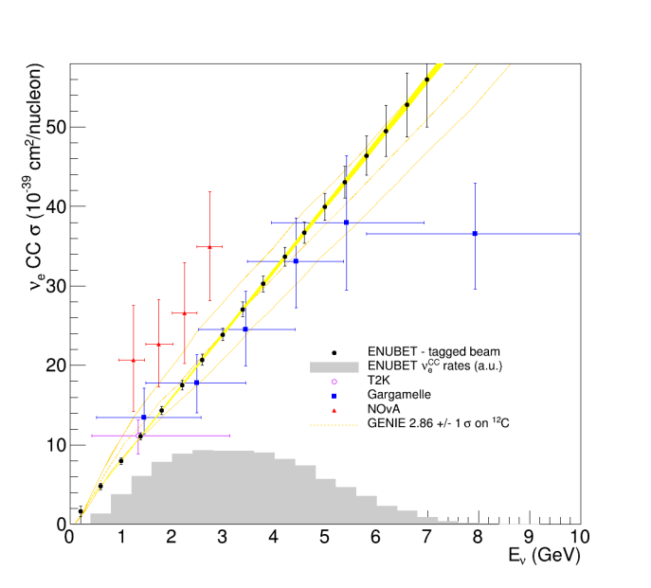
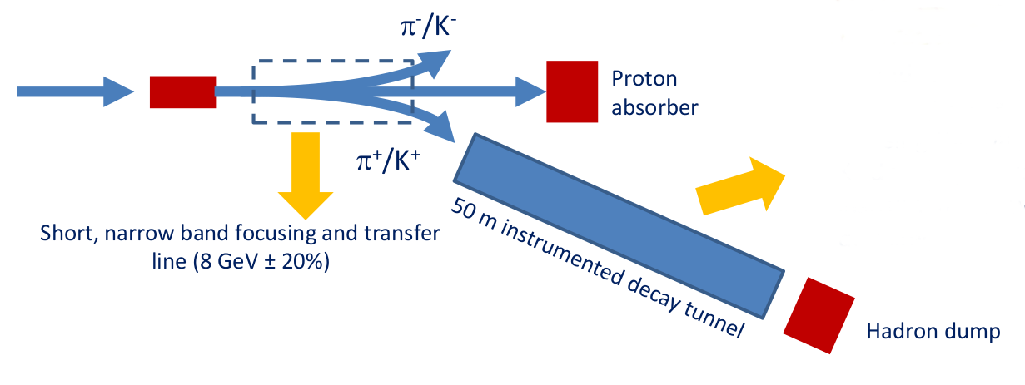
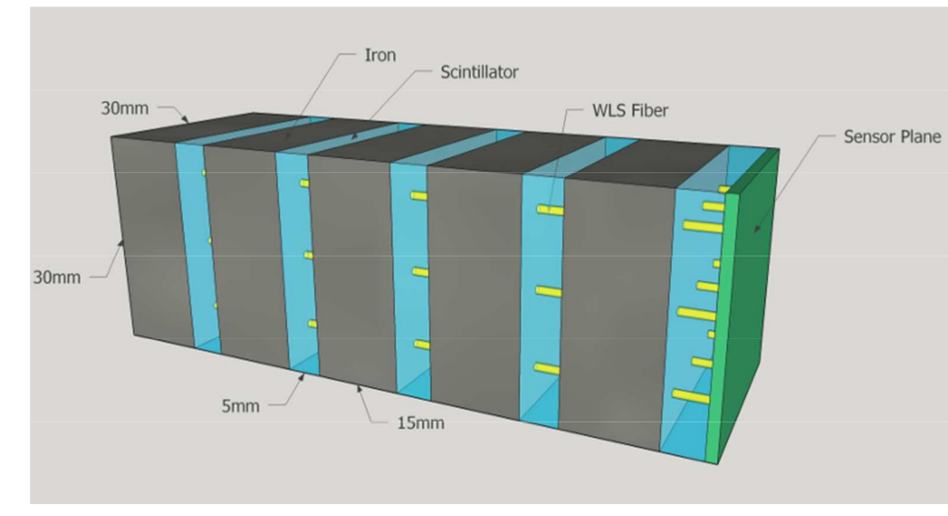
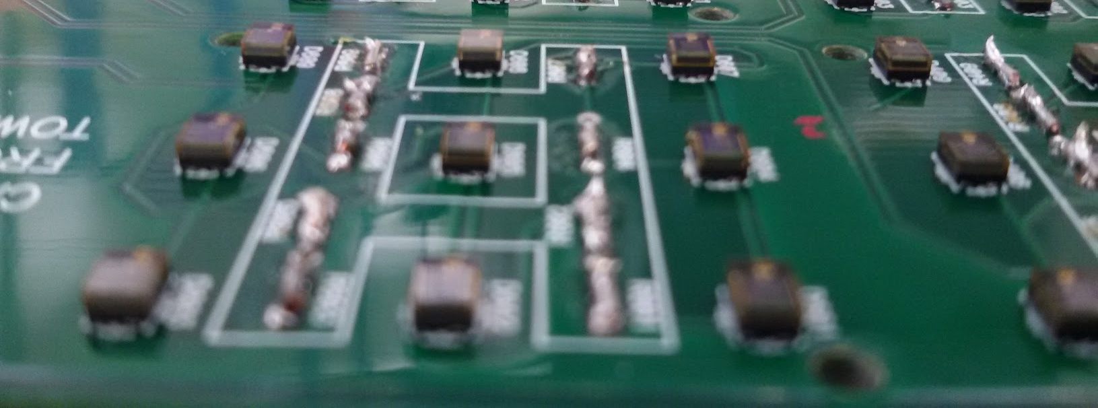
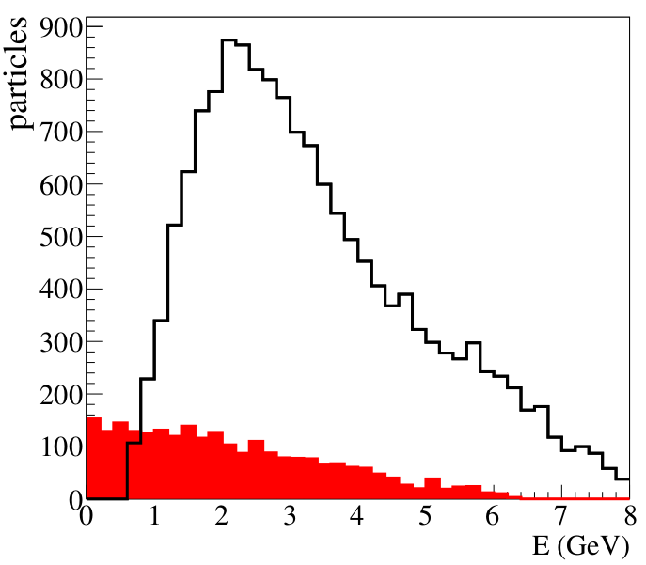
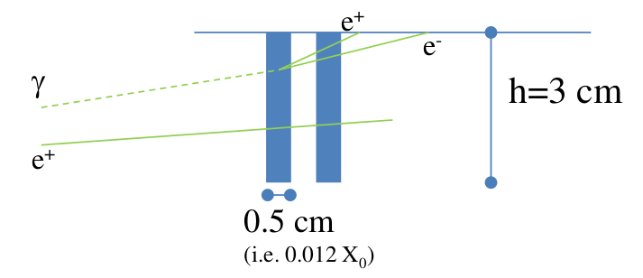
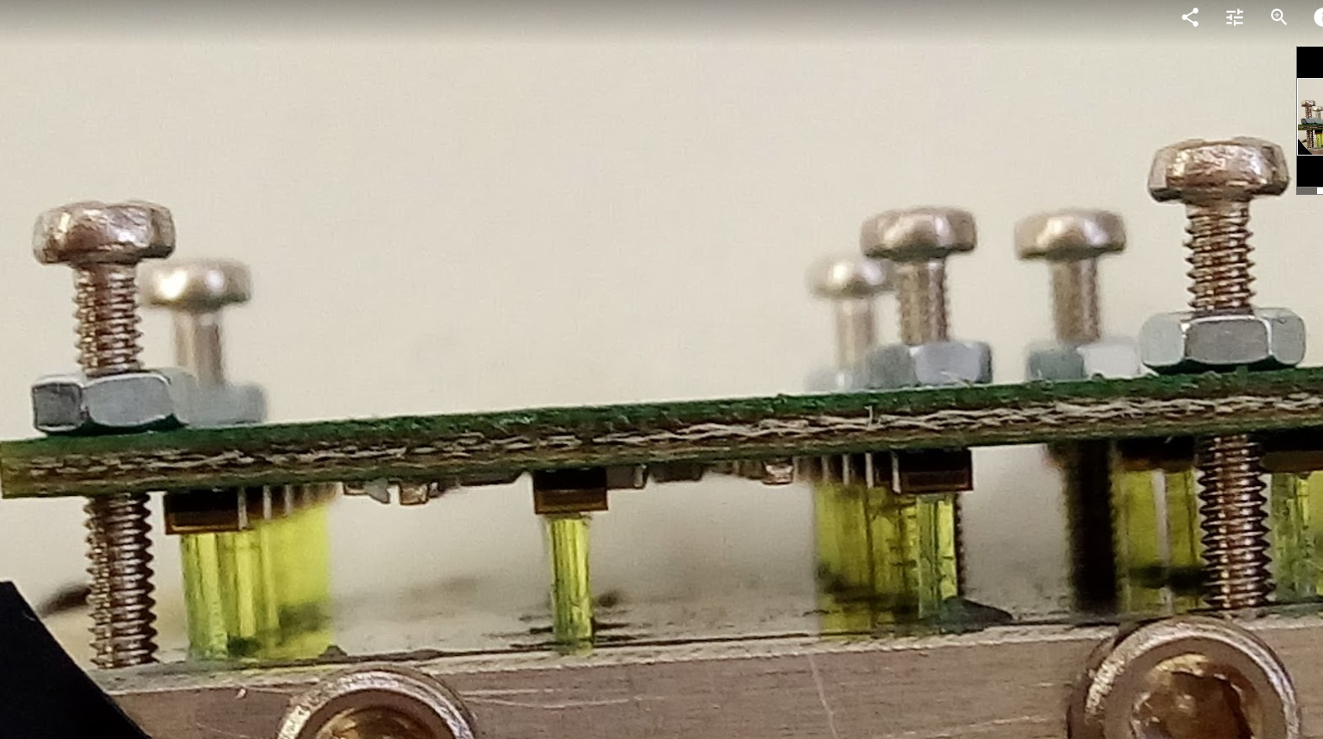
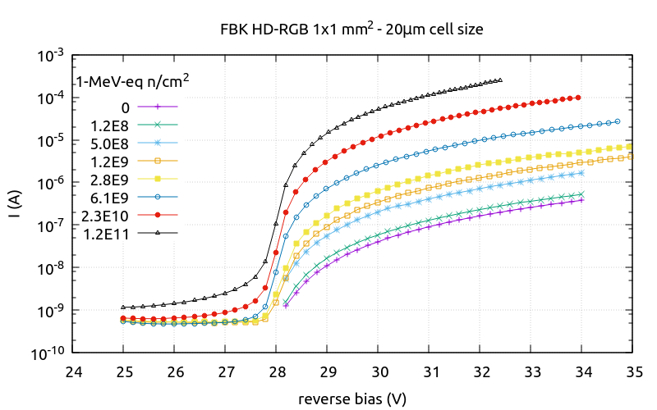
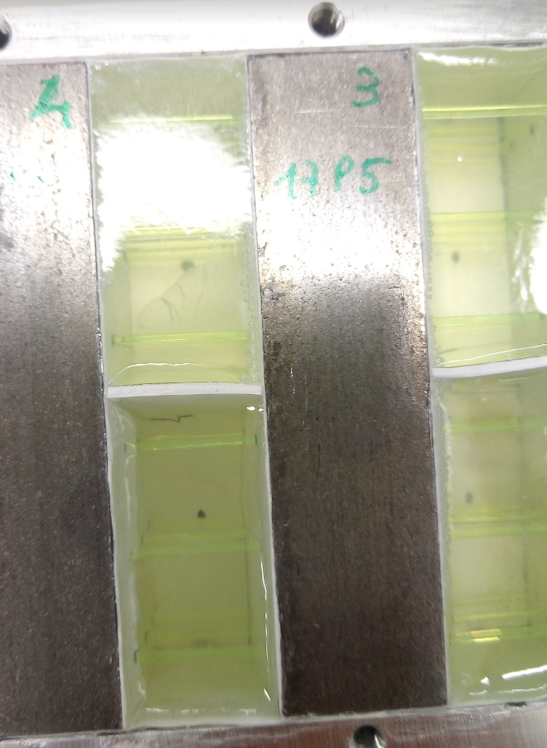
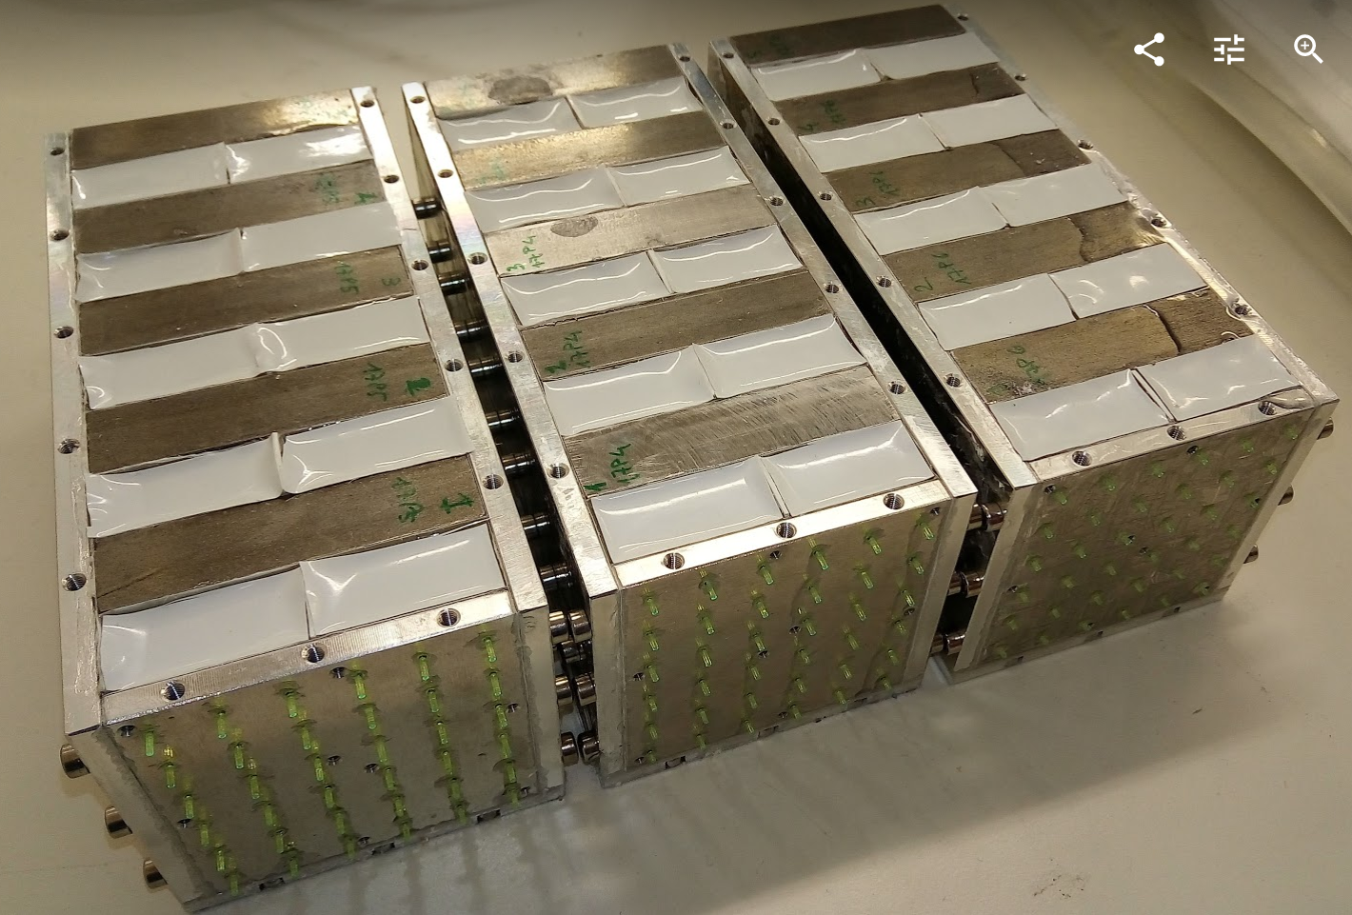
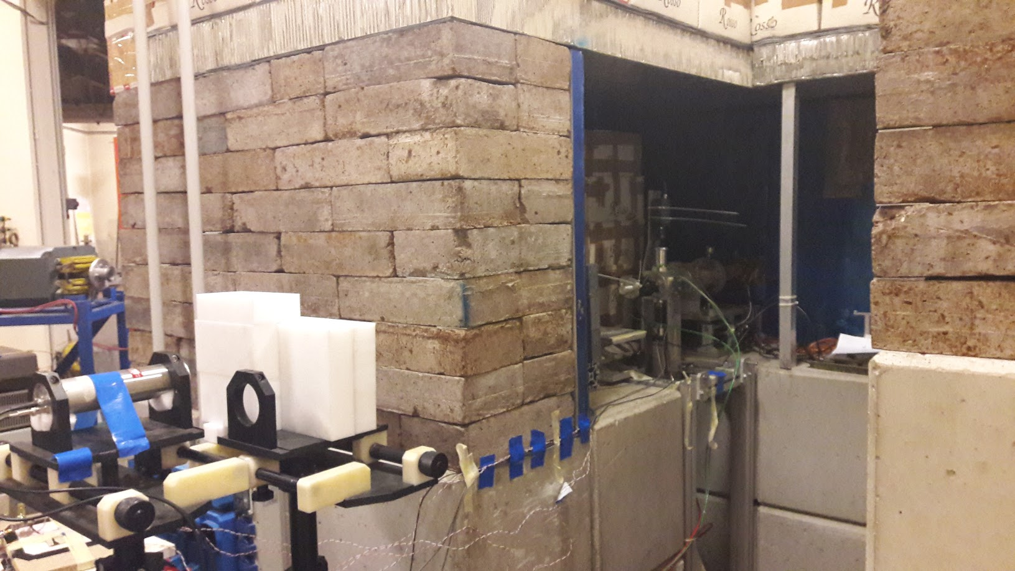
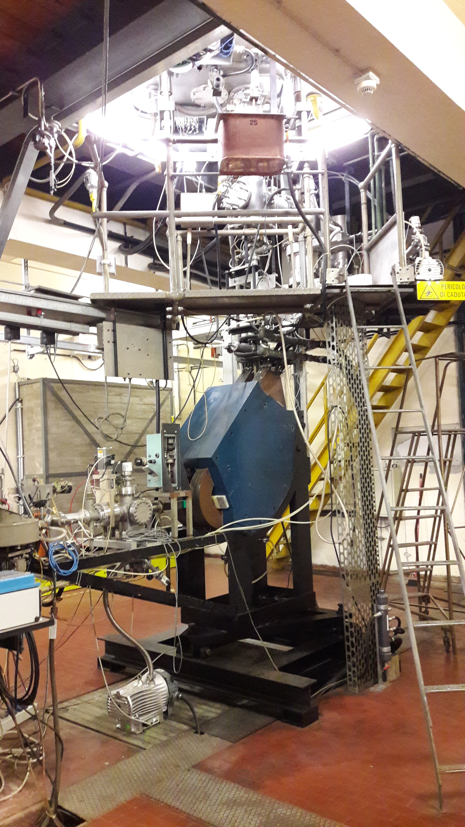
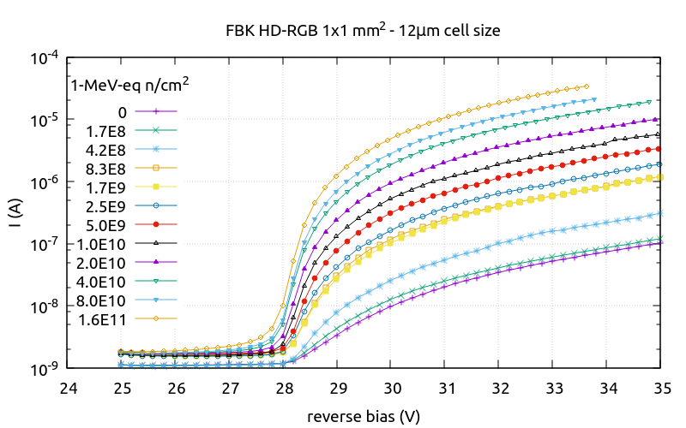
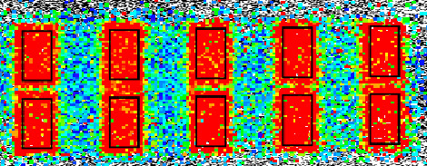
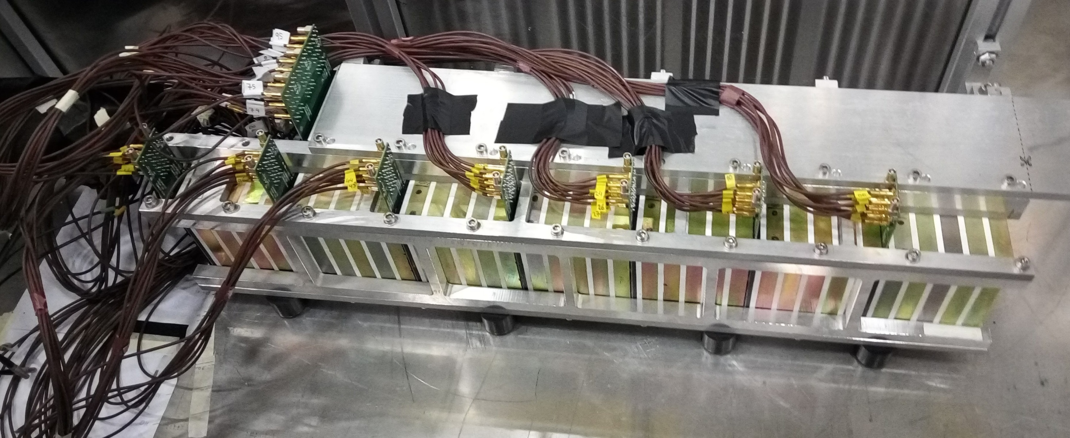
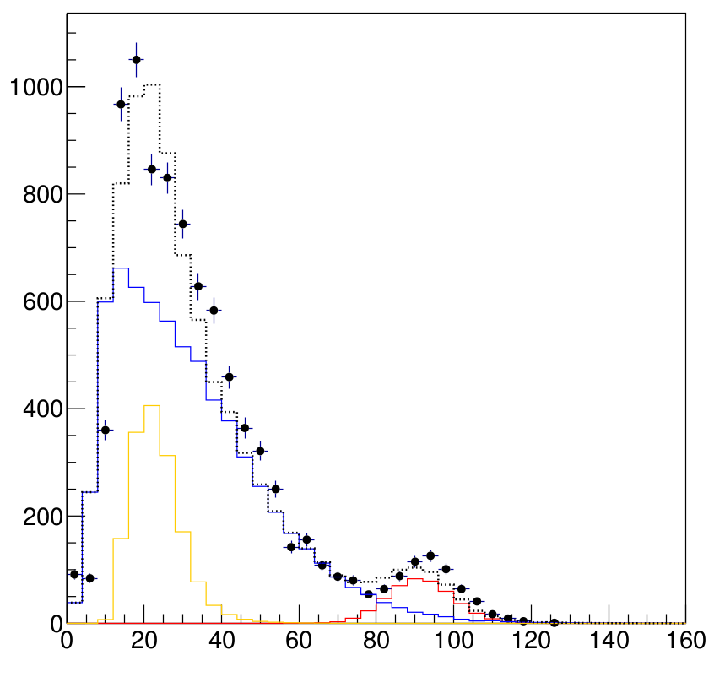
ENUBET
Enabling high precision flux measurements in conventional neutrino beams
G. Collazuol (University and INFN-Padova)
on behalf of the ENUBET collaboration
This project has received funding from the European Research Council (ERC) under the European Union’s Horizon 2020 research and innovation programme (grant agreement No 681647).
ENUBET (Enhanced NeUtrino BEams from kaon Tagging)
ENUBET impact on v_{e} cross section meas.
A new source based on tagging of large angle e⁺ from K⁺ → e⁺ π⁰ ν_{e} decays in an instrumented decay tunnel
Reduce systematic uncertainties in the knowledge of the neutrino flux to a O(1%) level [1]
ERC funded project (n. 681647, P.I. A. Longhin), Expression of Interest to CERN-SPSC [2]
Physics case and applications
A new generation of neutrino cross section experiments with unprecedented control on the flux
The first step toward a time-tagged v-beam, where the v at the detector is correlated with the lepton in the tunnel
A phase-II sterile neutrino search, especially in case of a positive signal from the FermiLab SBL program
Deliverables: 1) design of the hadron beamline 2) construction of a demonstrator of the instrumented tunnel (~ 3m)
Tagged neutrino beam
A traditional beam
The tagged beam
e⁺ tagger: real-time, ''inclusive'' monitoring of produced e⁺
Passive decay region
ν_{e} flux relies on ab-initio simulations of the full chain
large uncertainties from hadro-production, k/π ratio, PoT
↔
Fully instrumented decay region
K⁺→ e⁺ ν_{e} π⁰ → large angle e⁺
ν_{e} flux prediction = e⁺ counting
Hadron beam-line: collects, focuses, transports K⁺ to the e⁺ tagger
O(1%) systematic error achievable
The positron tagger
1) Calorimeter (“shashlik”) → π± rejection
1) compact calorimeter with
longitudinal segmentation
UCM (4 X₀ thick) read-out by SiPMs directly coupled to WLS
Ultra Compact Module (UCM)
a harsh environment:
particle rates: > 200 kHz/cm²
backgrounds: pions from K⁺ decays
2) integrated γ-veto
K⁺
e⁺
π⁺ background
2) Integrated γ –veto → π⁰ rejection
UCM
ν_{e}
rings of 3x3 cm² pads of plastic scintillator doublets
1 m.i.p./2 m.i.p. separation
alternative solutions allowing superior timing under study (large area fast APD, LAPPD with Cherenkov radiator)
e⁺ signal
extended source of ~ 50 m
grazing incidence
spread in the initial direction
Requirements:
Homogeneous longitudinal sampling
radiation hardness
cost effectiveness
2 m.i.p. E threshold
1 m.i.p. E threshold
Polysiloxane shashlik calorimeters
Tests of SiPM radiation-hardness
no plastic drilling/molding
higher rad. Hardness
optimal optical contact
Three 4.3 X₀ prototypes successfully tested at the CERN-PS (Oct. 2017)
Van de Graaff CN accelerator
@ INFN Laboratori Nazionali di Legnaro
p (5MeV)+⁹Be → n + X
p currents ~< 1uA
n spectrum ~1-3 MeV
Up to 10¹¹⁻¹² n-1MeV-eq/cm²
06/17: irradiation at LNL
08-10/17: tests at CERN
protons
FBK 20 um cell
bunker
Be target
n
n
n
SensL (2)
n
n
FBK 12 um cell
Tagger prototype tests at CERN
References
Full SuperModule with “hadronic” layers (coarse sampling)
Energy resolution for electrons
Electron/pion separation
http://enubet.pd.infn.it
EJ200 plastic scintillators
Y11 and BCF92 WLS fibers
FBK 20 um SiPM
In agreement with MC simulation
4 GeV/c
(100mrad tilt)
data (bullets)
MC p⁻ m⁻ e⁻
[1] Eur. Phys. J. C (2015) 75:155
A novel technique for the measurement of the electron neutrino cross section. A. Longhin, L. Ludovici, F. Terranova
[2] CERN-SPSC-2016-036 ; SPSC-EOI-014
Enabling precise measurements of flux in accelerator neutrino beams: the ENUBET project ENUBET Collaboration
[3] N.I.M. A, 2016.05.123 arXiv:1605:09630
Fe absorbers
A compact light readout system for longitudinally segmented shashlik calorimeters
[4]
PCB with SiPM
UCM
IEEE Trans.Nucl.Sci. 64 (2017) no.4, 1056-1061
Shashlik Calorimeters with embedded SiPM for Longitudinal Segmentation, ENUBET Collaboration.
SuperModule tested at CERN-PS East Area, T9 beamline – 01/11/2016
Prepared by G. Collazuol (Padova University and INFN-Padova, gianmaria.collazuol@pd.infn.it) for the IEEE-NSS-MIC 2017– Atlanta

