Slide 1
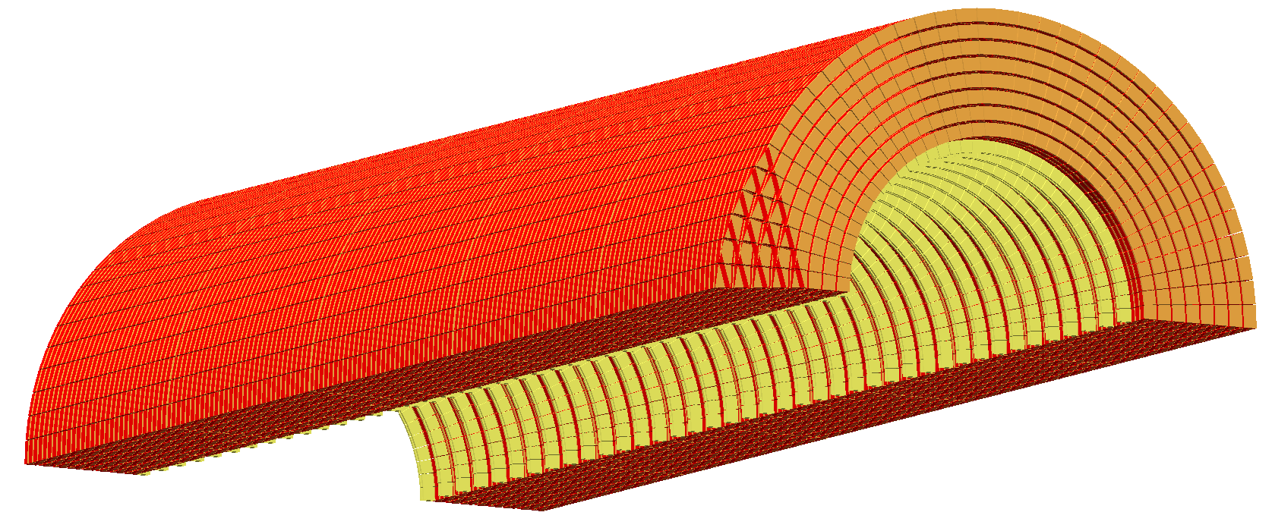
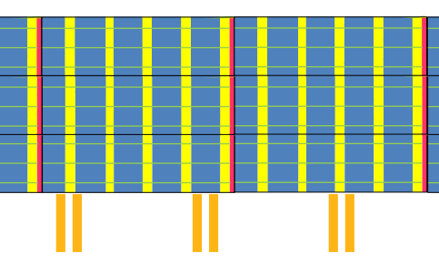
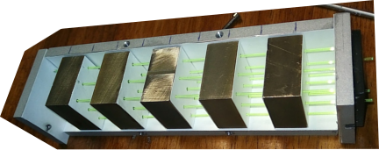
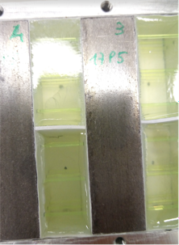
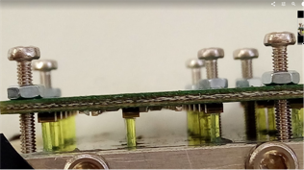
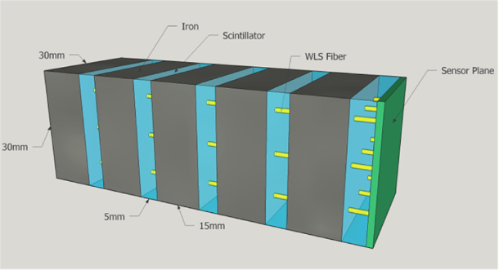
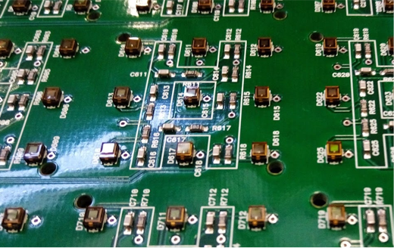
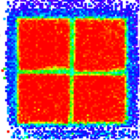
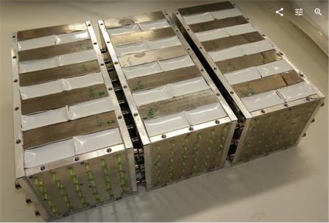
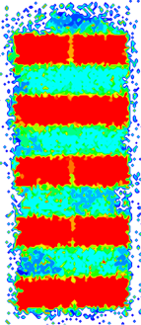
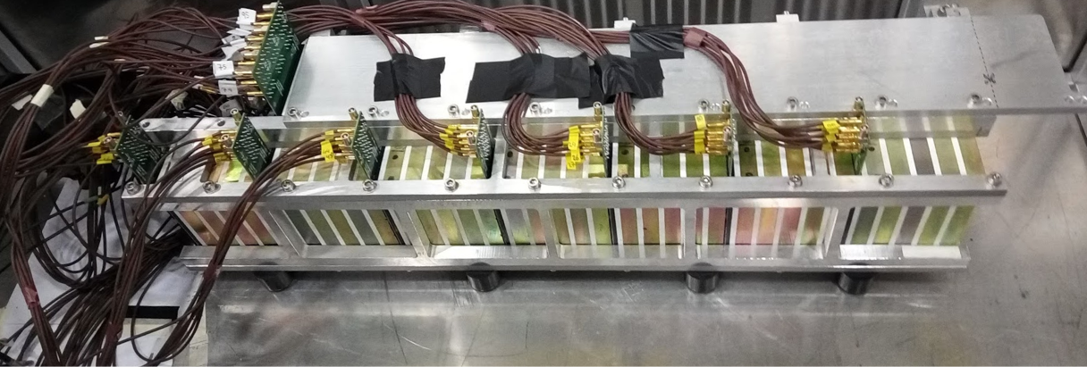
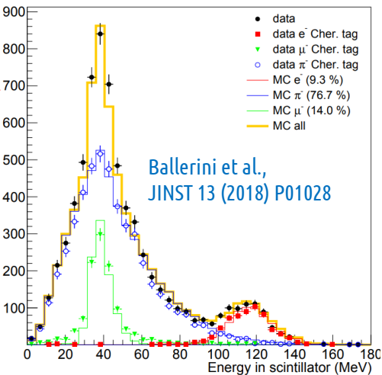
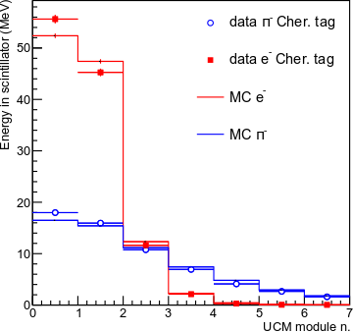
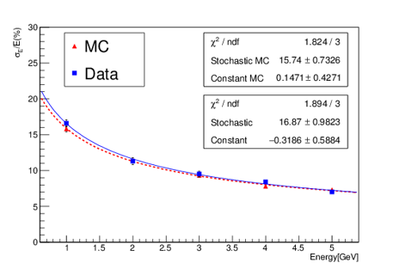
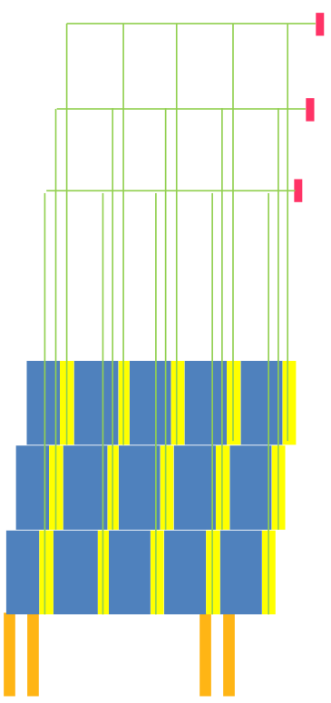
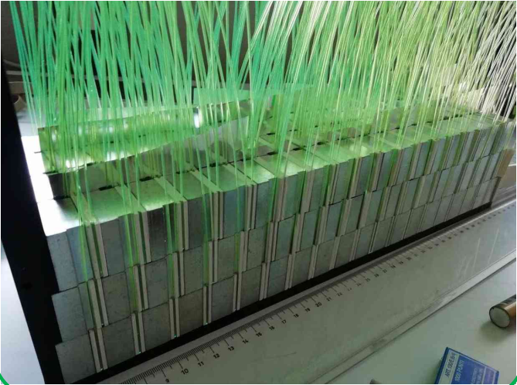
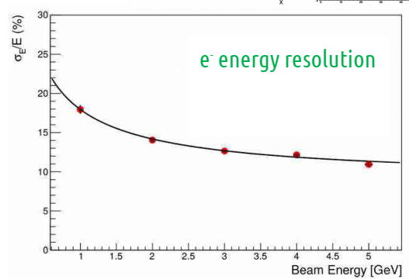
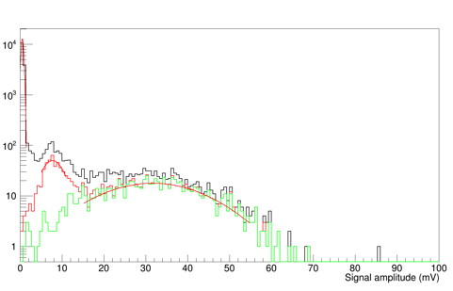
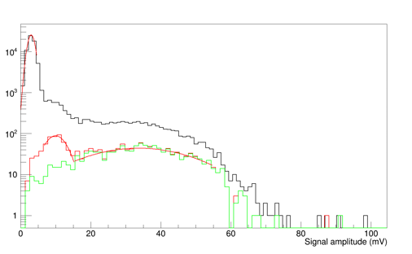
The
narrow band neutrino beam
Matteo Tenti on behalf of the ENUBET collaboration
Università degli Studi di Milano - Bicocca
and INFN - MIB
Requirements:
Radiation hardness
Cost effectiveness
ENUBET
(Enhanced NeUtrino BEams from kaon Tagging)
New-concept $ν_{e}$ source based on tagging of large angle $e^{+}$
from $K^{+}→e^{+}π^{0}ν_{e}$ decays in an instrumented decay tunnel (98% $ν_{e}$ from $K^{+}$ decays)
Reduction of the systematic uncertainties on the knowledge
of the initial neutrino flux to O(1%) level
Hadron beamline
collects, focuses, transports $K^{+}$ see G. Brunetti’s poster [ID 26]
Instrumented decay pipe
real-time, 'inclusive‘
monitoring of produced $e^{+}$
Physics programme
Unprecedented high precision measurement of $ν_{e}$ and ${\overline{ν}}_{e}$ cross sections
Highly beneficial for tackling the main open neutrino-related issues: leptonic CP violation (mass hierarchy, $θ_{23}$ octant)
First step towards a time tagged neutrino beam: direct production/detection correlation
Positron tagger
Longitudinally
segmented compact calorimeter
with integrated
photon veto
extended source of ~ 50 m
grazing incidence
spread in the initial direction
$$K^{+}$$
$$e^{+}$$
Requirements:
Radiation hardness
Cost effectiveness
Harsh environment:
Particle rate: $< 200 kHz/cm^{2}$
Background: pions from $K^{+}$ decays
$$ν_{e}$$
Ultra-Compact Calorimeter Module (UCM)
$$e^{+}$$
Ultra-Compact Calorimeter Prototypes
Shashlik with integrated readout Basic shashlik calorimeter: Scintillator / absorber sampling calorimeter,
read out by Wavelength Shifter (WLS) optical fibers, routed to PMT
Ultra-Compact shashlik prototype: basic iron/scintillator shashlik where each WLS fiber is read out by one single SiPM.
Electronic r/o in the bulk of detector: compact structure
Polysiloxane shashlik calorimeters
First use in HEP. Elastometric material with interesting properties
Superior radiation hardness (transparent after 10 kGy dose exposure)
Easier fabrication process: initial liquid form. No drilling of the scintillator.
Optimal optical contact with fibers
Schema UCM fibre
Accoppiamento
dove sono i sipm
Prototipo testato al CERN
Foto, come è fatto
Risultati
Irradiamento SiPM
A Legnaro: Foto
Risulati
Polixiloxano
Foto com’è fatto
Risultati
Lettura laterale foto+schema UCM e lettura
Meno radiazione per i SiPM
Foto prototipo
Risultati preliminari
Harsh environment:
Particle rate: $> 200 kHz/cm^{2}$
Background: pions from $K^{+}$ decays
$$1.7 R_{M}$$
Prototype tested @ CERN (PS-T9)
12 UCMs: 3 (beam direction) x 2 x 2
Active layer 3 times thicker: 15 mm compensate 30% lower light yield w.r.t. EJ200
Energy resolution: $17\%/\sqrt{E(GeV)}$ comparable with plastic scintillator based prototype
Good linearity: < 3% in the 1-5 GeV
Fiber-scintillator coupling after pouring is comparable to that obtained from injection molding of conventional scintillators
$$4.3 X_{0}$$
UCM readout
Tagger prototype tested @ CERN (PS-T9)
56 UCMs: 7 (beam direction) x 4 x 2 equivlent to 30.1 $X_{0}$ and 3.09 $λ$
UCM:
EJ200 plastic scintillator
Y11 & BCF92 WLS fibers
FBK 20 $μ$m SiPMs
Conclusioni polixiloxano: meno light yield ma compatibile con la resa di luce del materiale -> buchi non incidono
Se ce posto shashlik
Laterale risultati preliminary
beam
Lateral scintillation light readout Light collected from scintillator sides and bundled to a single SiPM reading 10 fibers
SiPM are not immersed anymore in the hadronic shower less compact but ..
Much reduced neutron damage (larger safety margins)
Better accessibility
Safer WLS-SiPM coupling.
Resolution, light yield, uniformity, optical coupling to photo-sensors, e/$π$ separation. In progress
PCBs with SiPMs
UCM
Fe Absorber
Scintillator tile
Energy distribution data/MC agreement
Energy deposit per UCM
e/$π$ separation
PCBs with SiPMs
Energy resolution $$∼17\%/\sqrt{E(GeV)}$$
Measures repeated with different tilt angle (from 0 to 200 mrad)
Data compared with Geant4 simulation of the detector (photon generation and transport not included)
Good e/$π$ separation based on longitudinal segmentation (mis-id. < 3%)
Energy resolution
Test of SiPM radiation-hardness
Van de Graaff CN accelerator at Laboratori Nazionali di Legnaro p (5 MeV) + ⁹Be $→$ n + X (p currents < 1 $μ$A, n ~ 1-3 MeV)
Test beam @CERN PS-T9
Photon veto
Uniformity
More information: enubet.pd.infn.it
Eur. Phys. J. C (2015) 75:155, A novel technique for the measurement of the electron neutrino cross section. A. Longhin, L. Ludovici, F. Terranova
CERN-SPSC-2016-036; SPSC-EOI-014, Enabling precise measurements of flux in accelerator neutrino beams: the ENUBET project. ENUBET Collaboration
IEEE Trans. Nucl. Sci. 64 (2017) 1056, Shashlik Calorimeters With Embedded SiPMs for Longitudinal Segmentation. A. Berra et al.
JINST 13 (2018) P01028 arXiv:1801.06167, Testbeam performance of a shashlik calorimeter with fine-grained longitudinal segmentation. G. Ballerini et al.
Loss of single p.e sensitivity after $3⋅{10}^{9}\text{1 }\text{MeV}\text{−}\text{eq} n/cm^{2}$
Constant MIP peak/e peak Equalization can be achieved with overvoltage
p = 1 GeV/c
p = 1 GeV/c
Irradiation: ${10}^{11}$ 1 MeV-eq $n/cm^{2}$
NuPhys2018: Prospects in Neutrino Physics, Cavendish Centre, 19-21 December 2018

